Slide 1
Short overview of Weka

Slide 2
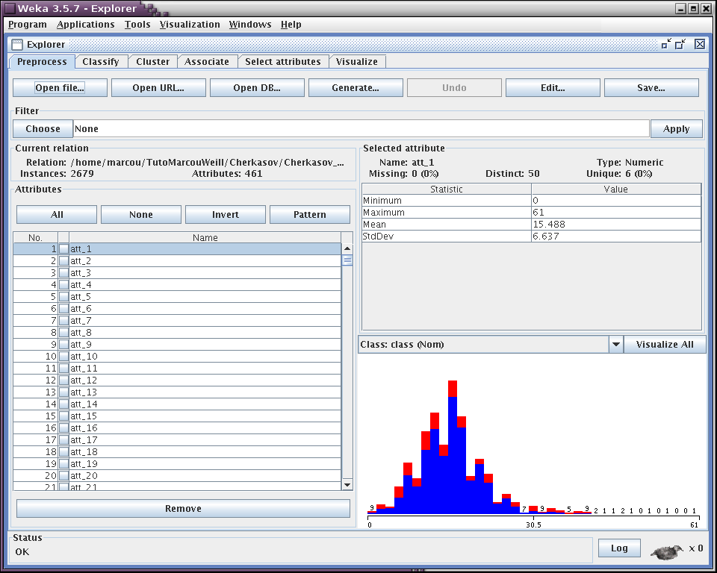
Weka: Explorer
Visualisation
Attribute selections
Association rules
Clusters
Classifications

Slide 3
Weka: Memory issues
Windows
  Edit the RunWeka.ini file in the directory of installation of Weka
  maxheap=128m -> maxheap=1280m
Linux
  Launch Weka using the command ($WEKAHOME is the installation directory of Weka)
  Java -jar -Xmx1280m $WEKAHOME/weka.jar

Slide 4
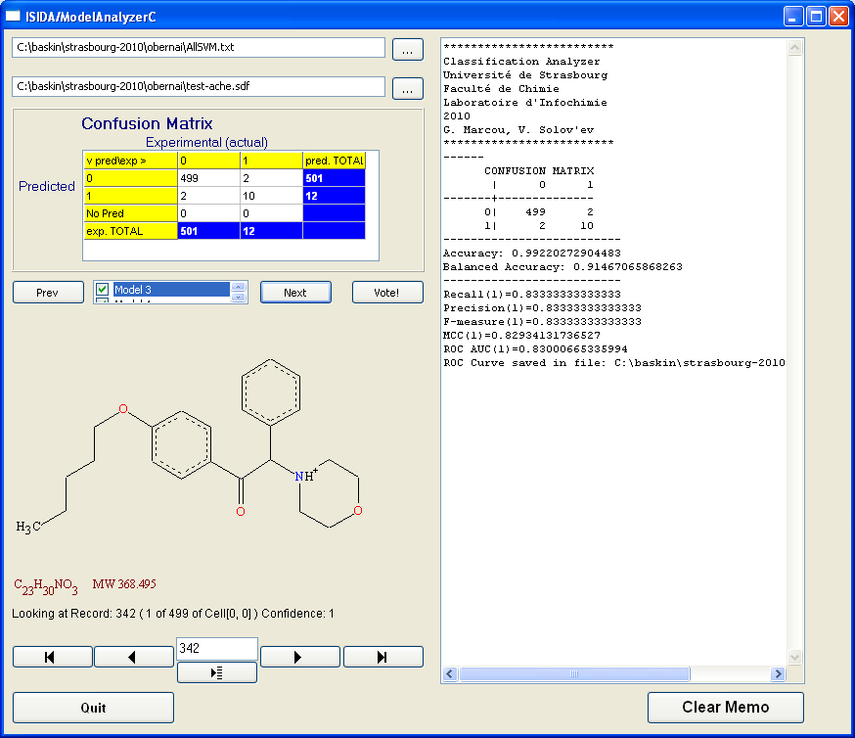
ISIDA ModelAnalyser
Features:
Imports output files of general data mining programs, e.g. Weka
Visualizes chemical structures
Computes statistics for classification models
Builds consensus models by combining different individual models

Slide 5
Foreword
For time reason:
  Not all exercises will be performed during the session
  They will not be entirely presented neither
Numbering of the exercises refer to their numbering into the textbook.

Slide 6
Ensemble Learning
Igor Baskin, Gilles Marcou and Alexandre Varnek

Slide 7


Hunting season …
Single hunter
Courtesy of Dr D. Fourches

Slide 8
Hunting season …
Many hunters

Slide 9
What is the probability that a wrong decision will be taken by majority voting?
Probability of wrong decision (μ < 0.5)
Each voter acts independently
More voters – less chances to take a wrong decision !

Slide 10
The Goal of Ensemble Learning
Combine base-level models which are
  diverse in their decisions, and
  complementary each other
Different possibilities to generate ensemble of models on one same initial data set
  Compounds
  Descriptors
  Machine Learning Methods
  Bagging and Boosting
  Random Subspace
  Stacking

Slide 11
Principle of Ensemble Learning
Perturbed sets
ENSEMBLE
Matrix 1
Learning
algorithm
Model
M1
Training set
D1
Dm
C1
Matrix 2
Learning
algorithm
Model
M2
Consensus
Model
Cn
Compounds/
Descriptor
Matrix
Matrix 3
Learning
algorithm
Model
Me

Slide 12
Ensembles Generation: Bagging
  Compounds
  Descriptors
  Machine Learning Methods
  Bagging and Boosting
  Random Subspace
  Stacking

Slide 13
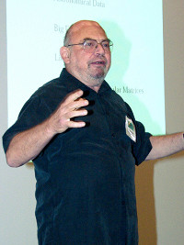
Bagging
Bagging = Bootstrap Aggregation
Introduced by Breiman in 1996
Based on bootstraping with replacement
Usefull for unstable algorithms (e.g. decision trees)
Leo Breiman
(1928-2005)
Leo Breiman (1996). Bagging predictors. Machine Learning. 24(2):123-140.

Slide 14
Bootstrap
Training set S
Sample Si from training set S
D1
Dm
D1
Dm
C1
C3
C2
C2
All compounds have the same probability to be selected
Each compound can be selected several times or even not selected at all (i.e. compounds are sampled randomly with replacement)
C3
Si
C2
C4
C4
.
.
.
.
.
.
Cn
C4
Efron, B., & Tibshirani, R. J. (1993). "An introduction to the bootstrap". New York: Chapman & Hall

Slide 15
Bagging
Data with
perturbed sets
of compounds
C4
ENSEMBLE
C2
C8
Learning
algorithm
Model
M1
S1
C2
Training set
C1
C1
C2
Voting (classification)
C9
C3
C7
S2
C2
Learning
algorithm
Model
M2
Consensus
Model
C4
C2
.
.
.
C1
Averaging (regression)
C4
Cn
Se
C1
C3
Learning
algorithm
Model
Me
C4
C8

Slide 16
Classification - Descriptors
ISIDA descritpors:
  Sequences
  Unlimited/Restricted Augmented Atoms
Nomenclature:
  txYYlluu.
    x: type of the fragmentation
    YY: fragments content
    l,u: minimum and maximum number of constituent atoms
Classification - Data
Acetylcholine Esterase inhibitors
( 27 actives, 1000 inactives)

Slide 17
Classification - Files
train-ache.sdf/test-ache.sdf
  Molecular files for training/test set
train-ache-t3ABl2u3.arff/test-ache-t3ABl2u3.arff
  descriptor and property values for the training/test set
ache-t3ABl2u3.hdr
  descriptors' identifiers
AllSVM.txt
  SVM predictions on the test set using multiple fragmentations

Slide 18
Regression - Descriptors
ISIDA descritpors:
  Sequences
  Unlimited/Restricted Augmented Atoms
Nomenclature:
  txYYlluu.
    x: type of the fragmentation
    YY: fragments content
    l,u: minimum and maximum number of constituent atoms
Regression - Data
Log of solubility
( 818 in the training set, 817 in the test set)

Slide 19
Regression - Files
train-logs.sdf/test-logs.sdf
  Molecular files for training/test set
train-logs-t1ABl2u4.arff/test-logs-t1ABl2u4.arff
  descriptor and property values for the training/test set
logs-t1ABl2u4.hdr
  descriptors' identifiers
AllSVM.txt
  SVM prodictions on the test set using multiple fragmentations

Slide 20
Exercise 1
Development of one individual rules-based model
(JRip method in WEKA)

Slide 21
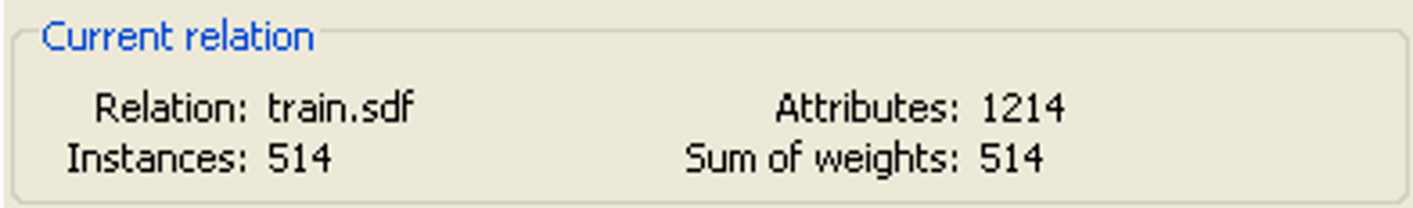
Exercise 1
Load train-ache-t3ABl2u3.arff

Slide 22
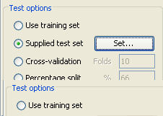
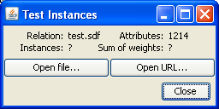
Exercise 1
Load test-ache-t3ABl2u3.arff

Slide 23
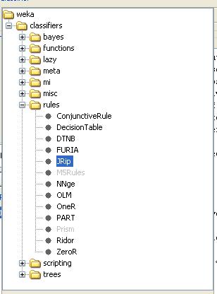
Exercise 1
Setup one JRip model

Slide 24
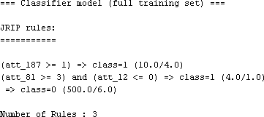
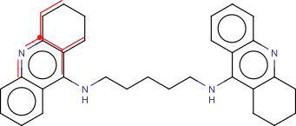
Exercise 1: rules interpretation
(C*C),(C*C*C),(C*C-C),(C*N),(C*N*C),(C-C),(C-C-C),xC*
(C-N),(C-N-C),(C-N-C),(C-N-C),xC
(C*C),(C*C),(C*C*C),(C*C*C),(C*C*N),xC

Slide 25
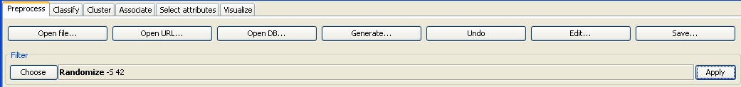
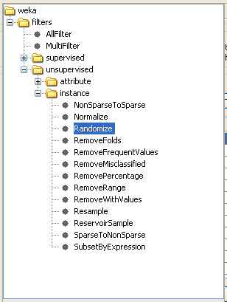
Exercise 1: randomization
What happens if we randomize the data
and rebuild a JRip model ?

Slide 26
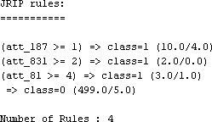
Exercise 1: surprizing result !
Changing the data ordering induces the rules changes

Slide 27
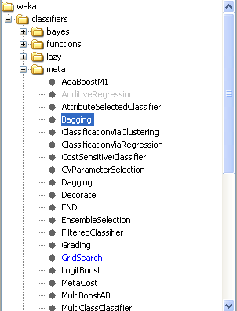
Exercise 2a: Bagging
Reinitialize the dataset
In the classifier tab, choose the meta classifier Bagging

Slide 28
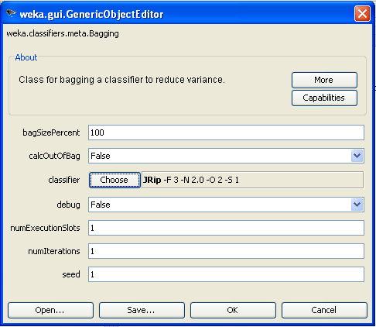
Exercise 2a: Bagging
Set the base classifier as JRip
Build an ensemble of 1 model

Slide 29
Exercise 2a: Bagging
Save the Result buffer as JRipBag1.out
Re-build the bagging model using 3 and 8 iterations
Save the corresponding Result buffers as JRipBag3.out and JRipBag8.out
Build models using from 1 to 10 iterations

Slide 30
Bagging
Classification
AChE
ROC AUC
ROC AUC of the consensus model as a function of the number of bagging iterations
Number of bagging iterations

Slide 31
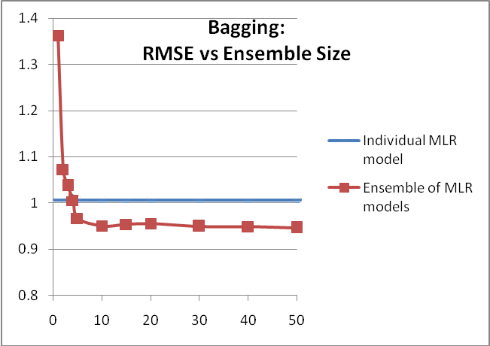
Bagging Of Regression Models

Slide 32
Ensembles Generation: Boosting
  Compounds
  Descriptors
  Machine Learning Methods
  Bagging and Boosting
  Random Subspace
  Stacking

Slide 33
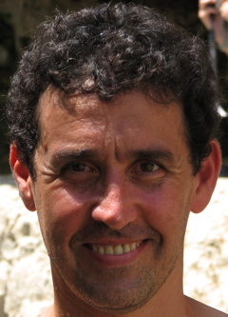


Boosting
Boosting works by training a set of classifiers sequentially by combining them for prediction, where each latter classifier focuses on the mistakes of the earlier classifiers.
AdaBoost - classification
Regression boosting
Yoav Freund
Robert Shapire
Jerome Friedman
Yoav Freund, Robert E. Schapire: Experiments with a new boosting algorithm. In: Thirteenth International Conference on Machine Learning, San Francisco, 148-156, 1996.
J.H. Friedman (1999). Stochastic Gradient Boosting. Computational Statistics and Data Analysis. 38:367-378.

Slide 34
Boosting for Classification. AdaBoost
w
C1
e
ENSEMBLE
w
C2
e
w
C3
e
w
C4
e
Learning
algorithm
Model
M1
Training set
.
.
.
S1
C1
w
Cn
e
S2
Weighted averaging & thresholding
C2
w
C1
e
C3
w
C2
e
w
C3
e
Learning
algorithm
Model
M2
Consensus
Model
C4
w
C4
e
.
.
.
.
.
.
w
Cn
e
Se
w
C1
Cn
w
C2
w
C3
Learning
algorithm
Model
Mb
w
C4
.
.
.
w
Cn

Slide 35
Developing Classification Model
Load train-ache-t3ABl2u3.arff
In classification tab, load test-ache-t3ABl2u3.arff

Slide 36
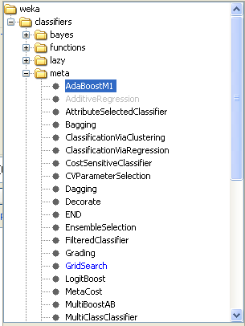
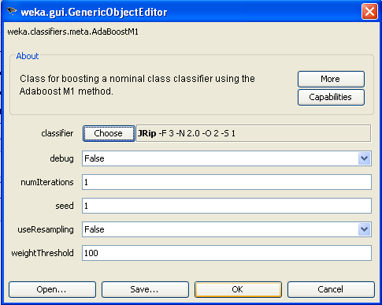
Exercise 2b: Boosting
In the classifier tab, choose the meta classifier AdaBoostM1
Setup an ensemble of one JRip model

Slide 37
Exercise 2b: Boosting
Save the Result buffer as JRipBoost1.out
Re-build the boosting model using 3 and 8 iterations
Save the corresponding Result buffers as JRipBoost3.out and JRipBoost8.out
Build models using from 1 to 10 iterations

Slide 38
Boosting for Classification. AdaBoost
Classification
AChE
ROC AUC
ROC AUC as a function of the number of boosting iterations
Log(Number of boosting iterations)

Slide 39
Bagging vs Boosting
Base learner – JRip
Base learner – DecisionStump

Slide 40
Conjecture: Bagging vs Boosting
Bagging leverages unstable base learners that are weak because of overfitting (JRip, MLR)
Boosting leverages stable base learners that are weak because of underfitting (DecisionStump, SLR)

Slide 41
Ensembles Generation: Random Subspace
  Compounds
  Descriptors
  Machine Learning Methods
  Bagging and Boosting
  Random Subspace
  Stacking

Slide 42

Random Subspace Method
Introduced by Ho in 1998
Modification of the training data proceeds in the attributes (descriptors) space
Usefull for high dimensional data
Tin Kam Ho
Tin Kam Ho (1998). The Random Subspace Method for Constructing Decision Forests. IEEE Transactions on Pattern Analysis and Machine Intelligence. 20(8):832-844.

Slide 43
Random Subspace Method: Random Descriptor Selection
Training set with initial pool of descriptors
C1
.
.
.
D1
D2
D3
D4
Dm
Cn
All descriptors have the same probability to be selected
Each descriptor can be selected only once
Only a certain part of descriptors are selected in each run
C1
D3
D2
Dm
D4
Cn
Training set with randomly selected descriptors

Slide 44
Random Subspace Method
Data sets with
randomly selected
descriptors
ENSEMBLE
S1
Learning
algorithm
Model
M1
D4
D2
D3
Voting (classification)
Training set
S2
Learning
algorithm
Model
M2
Consensus
Model
D1
D2
D3
D4
Dm
D1
D2
D3
Averaging (regression)
Learning
algorithm
Model
Me
Se
D4
D2
D1

Slide 45
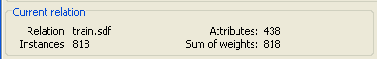
Developing Regression Models
Load train-logs-t1ABl2u4.arff
In classification tab, load test-logs-t1ABl2u4.arff

Slide 46
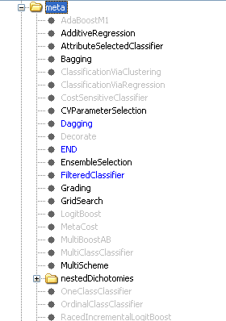
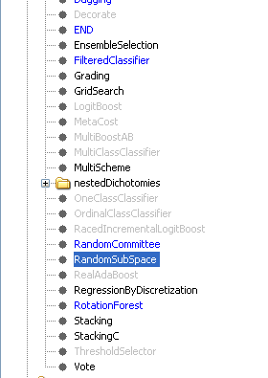
Exercise 7
Choose the meta method Random Sub-Space.

Slide 47
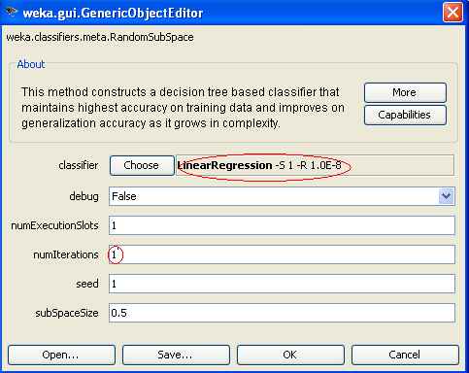
Exercise 7
Base classifier: Multi-Linear Regression without descriptor selection
Build an ensemble of 1 model
… then build an ensemble of 10 models.

Slide 48


Exercise 7
1 model
10 models

Slide 49
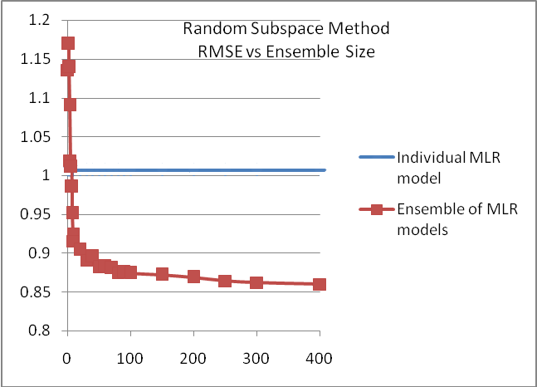
Exercise 7

Slide 50
Random Forest
Random Forest = Bagging + Random Subspace
Particular implementation of bagging where base level algorithm is a random tree
Leo Breiman
(1928-2005)
Leo Breiman (2001). Random Forests. Machine Learning. 45(1):5-32.

Slide 51
Ensembles Generation: Stacking
  Compounds
  Descriptors
  Machine Learning Methods
  Bagging and Boosting
  Random Subspace
  Stacking

Slide 52
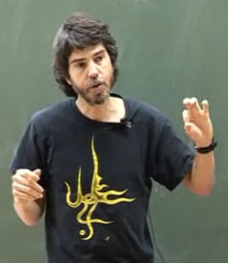
Stacking
Introduced by Wolpert in 1992
Stacking combines base learners by means of a separate meta-learning method using their predictions on held-out data obtained through cross-validation
Stacking can be applied to models obtained using different learning algorithms
David H. Wolpert
Wolpert, D., Stacked Generalization., Neural Networks, 5(2), pp. 241-259., 1992
Breiman, L., Stacked Regression, Machine Learning, 24, 1996

Slide 53
Stacking
The same data set
Different algorithms
ENSEMBLE
Data
set
S
Learning
algorithm
L1
Model
M1
Machine Learning Meta-Method
(e.g. MLR)
Training set
D1
Dm
C1
Data
set
S
Data
set
S
Learning
algorithm
L2
Model
M2
Consensus
Model
Cn
Data
set
S
Learning
algorithm
Le
Model
Me

Slide 54
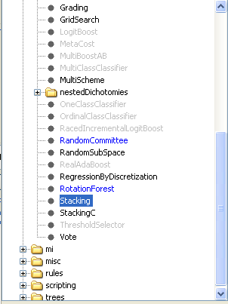
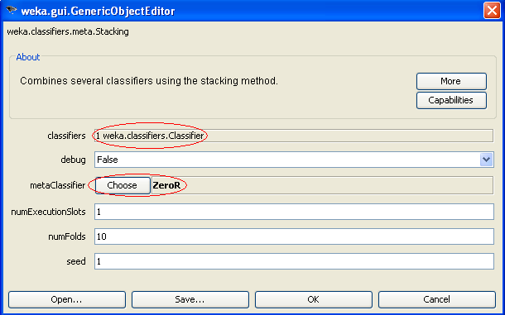
Exercise 9
Choose meta method Stacking
Click here

Slide 55
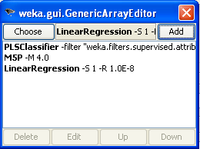
Exercise 9
Delete the classifier ZeroR
Add PLS classifier (default parameters)
Add Regression Tree M5P (default parameters)
Add Multi-Linear Regression without descriptor selection

Slide 56
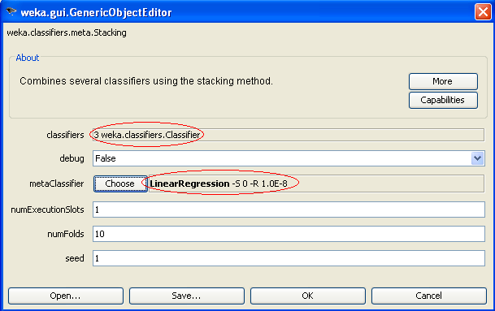
Exercise 9
Select Multi-Linear Regression as meta-method
Click here

Slide 57


Exercise 9

Slide 58
Exercise 9
Rebuild the stacked model using:
kNN (default parameters)
Multi-Linear Regression without descriptor selection
PLS classifier (default parameters)
Regression Tree M5P

Slide 59
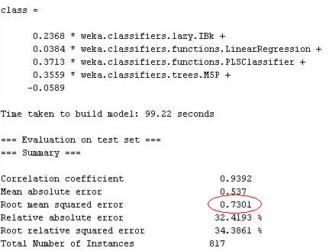
Exercise 9

Slide 60
Exercise 9 - Stacking
Learning algorithm | R (correlation coefficient) | RMSE
MLR | 0.8910 | 1.0068
PLS | 0.9171 | 0.8518
M5P (regression trees) | 0.9176 | 0.8461
1-NN (one nearest neighbour) | 0.8455 | 1.1889
Stacking of MLR, PLS, M5P | 0.9366 | 0.7460
Stacking of MLR, PLS, M5P, 1-NN | 0.9392 | 0.7301
Regression models
for LogS

Slide 61
Conclusion
Ensemble modeling converts several weak classifiers (Classification/Regression problems) into a strong one.
There exist several ways to generate individual models
  Compounds
  Descriptors
  Machine Learning Methods

Slide 62
Thank you… and
Questions?
Ducks and hunters, thanks to D. Fourches

Slide 63
Exercise 1
Development of one individual rules-based model
for classification (Inhibition of AChE)
One individual rules-based model is very unstable: the rules change as a function of ordering the compounds in the dataset

Slide 64
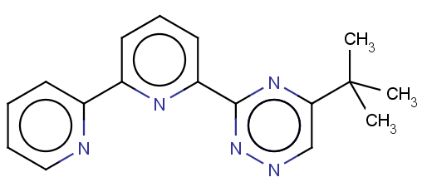
Model 1
model 2
Model 3
Model 4
Ensemble modelling

Slide 65
MLR
SVM
kNN
NN
Ensemble modelling

