Slide 1
Tutorial 2: QSAR modeling of compounds profiling
4th Chemoinformatics Strasbourg Summer Shool
G. Marcou, D. Horvath and A. Varnek

Slide 2
Introduction
Compound profiling : array of additional information about a compound.
  compound-target information, toxicities, partition coefficients, etc.
Experimental profiling information is common
  Dopamine: sub-μM activity on 13 targets ^{(PubChem June 2014)}
Receptors |  |  |  |  | Transporters
D1 | D2 | D3 | D4 | D5 | DAT | NET
Endonucleases |  | Transcription factors |  | Others
APE1 | FEN1 | RecQ-fam | TDP1 | GLSp | HSD17B

Slide 3
Goals of the tutorial
In the context of QSAR compound profiling:
  Introduce Multi-Task Learning methods
    What it is?
    Is it useful? How does it validate?
    Is it better? When does it work?
  Introduce l₁-norm regularized regressions (LASSO)
    Characterization?
    Parameterization?
Introduce MATLAB (MathWorks®)

Slide 4
Plan
Dataset
Single Task Learning (STL) / Multi-Task Learning (MTL)
Exercise 0: A brief overview of MATLAB
Exercise 1: The l₁-norm (LASSO) STL algorithm
Exercise 2: The l₁-norm (LASSO) MTL algorithm
Exercise 3: Parameter optimization
Exercise 4: The l₂₁-norm MTL algorithm
Exercise 5: Benchmarking
Conclusion

Slide 5
Dataset
Dataset
Single Task Learning (STL) / Multi-Task Learning (MTL)
Exercise 0: A brief overview of MATLAB
Exercise 1: The l₁-norm (LASSO) STL algorithm
Exercise 2: The l₁-norm (LASSO) MTL algorithm
Exercise 3: Parameter optimization
Exercise 4: The l₂₁-norm MTL algorithm
Exercise 5: Benchmarking
Conclusion

Slide 6
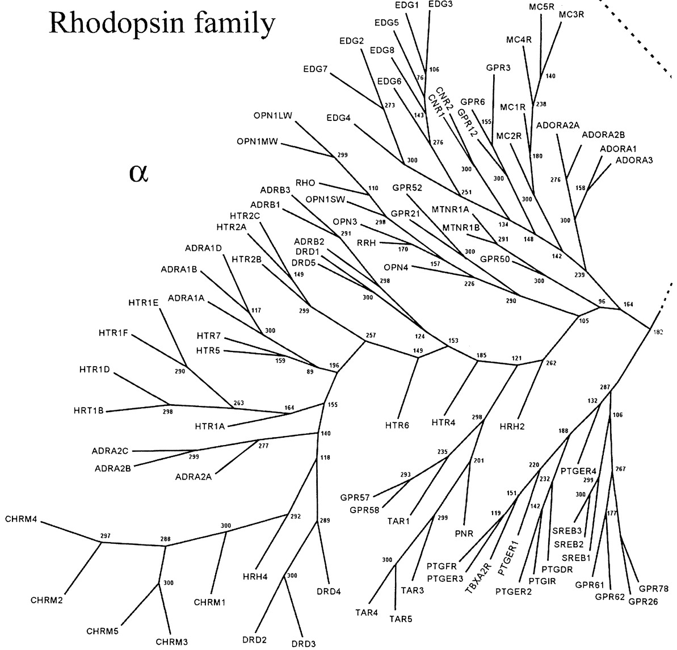
The dopamine receptor dataset
Affinity data (pKi): 2965
Unique molecules: 1597
5 members in the dopamine receptor family.
For each compound affinity data are available for
One dopamine receptor: 41%
Two dopamine receptors: 38%
Three dopamine receptors: 17%
Four dopamine receptors: 3%
All five dopamine receptors: 1%
doi: 10.1124/mol.63.6.1256
Molecular Pharmacology June 2003 vol. 63 no. 6 1256-1272

Slide 7
Modeling strategies
Dopamine Receptor | D1 | D2 | D3 | D4 | D5
Number of compounds | 272 | 1325 | 846 | 424 | 98
Each dataset is considered independently
Model D1
Model D2
Model D3
Model D4
Model D5
Estimates
Dopamine Receptor | D1 | D2 | D3 | D4 | D5
Outcome: 5 models, 1 output each

Slide 8
Modeling strategies
Dopamine Receptor | D1 | D2 | D3 | D4 | D5
Number of compounds | 272 | 1325 | 846 | 424 | 98
All datasets are considered simultaneously
Model
D1/D2/D3/D4/D5
Estimates
Dopamine Receptor | D1 | D2 | D3 | D4 | D5
Outcome: 1 models, 5 output

Slide 9
Single Task Learning (STL) / Multi-Task Learning (MTL)
Dataset
Single Task Learning (STL) / Multi-Task Learning (MTL)
Exercise 0: A brief overview of MATLAB
Exercise 1: The l₁-norm (LASSO) STL algorithm
Exercise 2: The l₁-norm (LASSO) MTL algorithm
Exercise 3: Parameter optimization
Exercise 4: The l₂₁-norm MTL algorithm
Exercise 5: Benchmarking
Conclusion

Slide 10
Single-task, Multi-class, Multi-label, Multi-task
=f(
)
Property
Y
Molecular Descriptors
X
Case 1: Y is binary class
Case 2: Y is continuous
Single Task. Classical SAR.
Example: Active/Inactive discrimination against a biological target
Popular algorithms: Naïve Bayes, Random Forest, SVM
Case 3: Y is nominal
Case 4: Y is a fixed length vector
Case 5: Y is a fixed length vector with missing values

Slide 11
Single-task, Multi-class, Multi-label, Multi-task
=f(
)
Property
Y
Molecular Descriptors
X
Case 1: Y is binary class
Case 2: Y is continuous
Single Task. Classical QSAR.
Example: Aqueous solubility modeling
Popular algorithms: MLR, rSVM
Case 3: Y is nominal
Case 4: Y is a fixed length vector
Case 5: Y is a fixed length vector with missing values

Slide 12
Single-task, Multi-class, Multi-label, Multi-task
=f(
)
Property
Y
Molecular Descriptors
X
Case 1: Y is binary class
Case 2: Y is continuous
Multi-class problems.
Classes are mutually exclusive.
Example: Qualitative estimation of bio-disponibility in blood circulation
Most algorithms are combining binary decision surfaces.
Case 3: Y is nominal
Case 4: Y is a fixed length vector
Case 5: Y is a fixed length vector with missing values

Slide 13
Single-task, Multi-class, Multi-label, Multi-task
=f(
)
Property
Y
Molecular Descriptors
X
Case 1: Y is binary class
Case 2: Y is continuous
Multi-label problems.
Example: theoretical RMN spectra from chemical structure, narcoleptics
Popular algorithms: PLS
Learn relations between labels.
Take advantage of inter-label contrains.
Case 3: Y is nominal
Case 4: Y is a fixed length vector
Case 5: Y is a fixed length vector with missing values

Slide 14
Single-task, Multi-class, Multi-label, Multi-task
=f(
)
Property
Y
Molecular Descriptors
X
Case 1: Y is binary class
Case 2: Y is continuous
Multi-task problems.
Example: Chemogenomics
Popular algorithms:
Neural Networks
Take advantage of tasks relatedness
Case 3: Y is nominal
Case 4: Y is a fixed length vector
Case 5: Y is a fixed length vector with missing values

Slide 15
Independent STL to solve multi-tasks problems
Multi-tasks problems can be solved using independent STL strategies
Problems
  Each STL must be individually optimized
  Each STL must be individually validated
  Each STL must be individually applied
  Each STL must be individually maintained
This is tedious

Slide 16
Definition of MTL
Tasks shall be learned simultaneously
  Unique optimization for all tasks
  Unique validation for all tasks
  Unique model to apply
  Unique model to maintain
Learning tasks shall interfere
Take advantage of tasks relatedness
Better generalization of models
Inductive transfer/transfer learning

Slide 17
Exercise 0: A brief overview of MATLAB
<Your path>/CS3_2014/Tutorials/QSPR_Profiling/Exercises/Exo0.m
Dataset
Single Task Learning (STL) / Multi-Task Learning (MTL)
Exercise 0: A brief overview of MATLAB
Exercise 1: The l₁-norm (LASSO) STL algorithm
Exercise 2: The l₁-norm (LASSO) MTL algorithm
Exercise 3: Parameter optimization
Exercise 4: The l₂₁-norm MTL algorithm
Exercise 5: Benchmarking
Conclusion

Slide 18
Get and activate the trial copy
If it is not yet done:
Create a personal MathWorks account at http://www.mathworks.com
Login at http://www.mathworks.com as:
  Login: g.marcou@unistra.fr
  Password: Gil$5000
Click on My Account, then on Manage Trials, Pre-releases and Betas
Select one Trial version, then click the End Users and License Contacts tab
Add your account to the users of the trial version and logout
Login as yourself and search for the activated trial version (see point 3)
Download and install MATLAB
During installation register your copy using your MathWorks account.
For Linux and Mac users: DO NOT USE THE BUILD-IN DOCUMENTATION SYSTEM

Slide 19
Get and Install MALSAR
MALSAR is a MATLAB library proposing many MTL algorithms
MALSAR means: Multi-tAsk Learning via StructurAl Regularization
Download MALSAR
  http://www.public.asu.edu/~jye02/Software/MALSAR/downloads/MALSAR1.1.zip
Unzip the file
For Linux users add the MALSAR installation path to MATLAB’s search path and run the file INSTALL.M

Slide 20
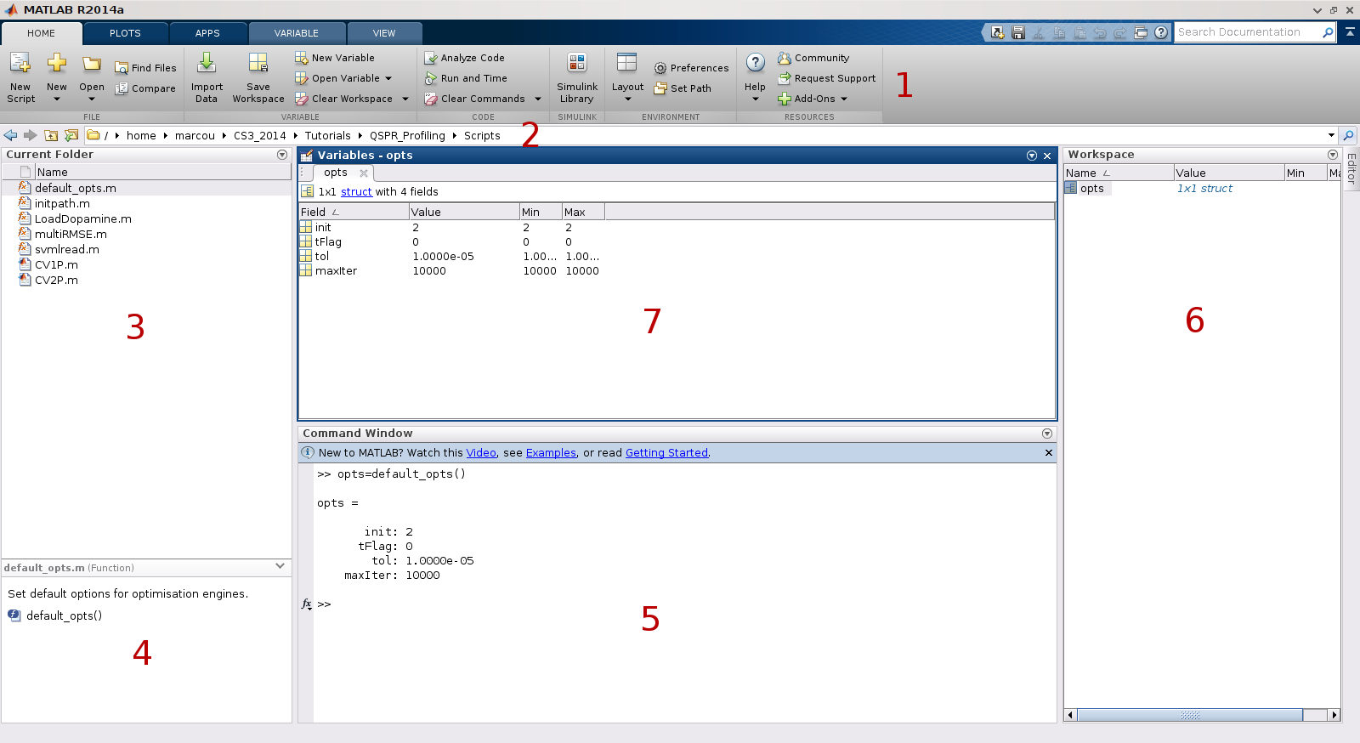
MATLAB main menu
The file and folder management
The Command Window
The main menu banner
The Variables editor
The Workspace

Slide 21
MATLAB search path
Exo0
Copy/Paste
addpath(genpath(‘<YourPath>/CS3_2014/Tutorials/QSPR_Profiling’));
addpath(genpath(‘<YourPath>/MALSAR’));
MATLAB can use any file that it can locate into its search path
Exo0
Copy/Paste
For instance
this command opens the file scmlread.m located into this tutorial’s directory.
edit(‘svmlread’);

Slide 22
Read and prepare one dataset
Exo0
Copy/Paste
[Y,X]=svmlread('Dopamine-D1.svm');
X=full(X);
X=zscore(X);
X=[X,ones(size(X,1),1)];
Add a column of 1 to X to simulate models with constant
add a constant descriptor of value 1 for all compounds
The matrix descriptor is sparse by default (zeros are implicit).
We need a full representation (zeros are explicit)
Read the dopamine D1 datasets:
for each compound, the molecular descriptors (X) and the pKi (Y)
Standardize descriptors’ values per column
X is a matrix, lines are compounds, columns are descriptors

Slide 23
Get all dopamine receptors dataset
aDopa=[1,2,3,4,5];
nDopa=length(aDopa);
X=cell(1,nDopa); Y=cell(1,nDopa);
for t=1:nDopa
i=aDopa(t);
[Yl,Xl]=svmlread(strcat('Dopamine-D',int2str(i),'.svm'));
Xl=full(Xl);
Xl=zscore(Xl);
Xl=[Xl,ones(size(Xl,1),1)];
X{t}=Xl; Y{t}=Yl;
end
Exo0
Copy/Paste
Store each dataset in a separate cell of a table
X stores the molecular descriptors matrices
Y stores the vectors of pKi
Keep track of the number of dataset
it is also the number of tasks
Read and prepare each dataset and store them
Store an index for each dataset

Slide 24
End of Exercise
Exo0
Copy/Paste
% An array of dopamine dopamine subfamily codes
lDopa=transpose(arrayfun(@(x) strcat('D',int2str(x)),aDopa,'UniformOutput',false));
A line starting with a % is a comment. It is not interpreted.
MATLAB is functional language.
This intricate command creates a list of 5 words: ‘D1’, ‘D2’, ‘D3’, ‘D4’, ‘D5’.

Slide 25
Summary
MATLAB should be installed
MATLAB search path should be set
Dopamine receptors datasets shall be loaded :
  X: an array of molecular descriptors matrices
  Y: an array of vectors of pKi

Slide 26
Exercise 1: The l₁-norm (LASSO) STL algorithm
Dataset
Single Task Learning (STL) / Multi-Task Learning (MTL)
Exercise 0: A brief overview of MATLAB
Exercise 1: The l1-norm (LASSO) STL algorithm
Exercise 2: The l₁-norm (LASSO) MTL algorithm
Exercise 3: Parameter optimization
Exercise 4: The l₂₁-norm MTL algorithm
Exercise 5: Benchmarking
Conclusion

Slide 27
The LASSO algorithm
LASSO: Least Absolute Shrinkage and Selection Operator
How does it works? Minimize the objective function
It produces multi-linear least square regression models
with a l₁-norm regularizer

Slide 28
Characteristics of the LASSO algorithm
The objective function is not differentiable everywhere.
  No analytical solution
  MALSAR uses Accelerated Gradient Methods to optimize this function.
Exo1
Copy/Paste
edit('default_opts.m');
%
opts=default_opts;
The l1-norm regularization acts as a variable selection
  To satisfy the constraint, the weight of all unnecessary descriptors are set to zero.

Slide 29
Build and apply a LASSO model
Exo1
Copy/Paste
prc=0.3;
[Xtr, Ytr, Xte, Yte]=mtlSplit(X, Y, prc);
Split the dataset: 70% training and 30% test
Exo1
Copy/Paste
p1=5;
[W, funcval]=Least_Lasso(Xtr(1,1),Ytr(1,1),p1,opts);
Learn a model on the training set for dopamine D1.
Weights are in W.
Optimization convergence can be examined in funval.
Exo1
Copy/Paste
Yp=Xte{1,1}*W;
Apply the model on the test set descriptors.
Get estimated values in Yp.

Slide 30
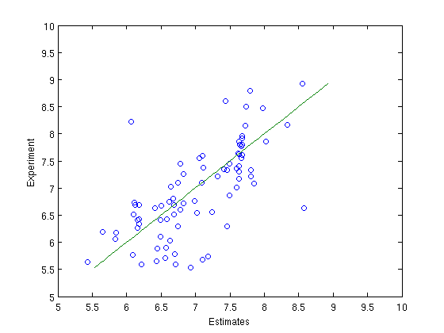
Validate the model
Exo1
Copy/Paste
SSE=sum((Yp-Yte{1,1}).^2);
SST=sum((Yte{1,1}-mean(Y{1,1})).^2);
R2=1-SSE/SST;
RMSE=sqrt(SSE/size(Yte{1,1},1));
fprintf('RMSE=%g R2=%g\n ',RMSE,R2);
Compute and print Root Mean Squared Error (RMSE) and Determination Coefficient (R2).
Exo1
Copy/Paste
plot(Yp,Yte{1,1},'o',Yte{1,1},Yte{1,1},'-');
xlabel('Estimates');
ylabel('Experiment');
xlim([5,10]);
ylim([5,10]);
Draw the scatter plot of estimated against experimental pKi for D1.

Slide 31
STL LASSO models for all dopamine receptors taks
Exo1
Copy/Paste
STL=cell(3,nDopa);
STL_W=cell(1,nDopa);
STL stores RMSE, R2 and estimates for each task
STL_W stores the model of each task

Slide 32
STL LASSO models for all dopamine receptors taks
for t=1:nDopa
i=aDopa(t);
fprintf('******** ');
fprintf('Dopamine D%i\n',aDopa(t)); [STL_W{1,t},funcval]=Least_Lasso(Xtr(1,t),Ytr(1,t),p1,opts); [STL{1,t},STL{2,t},STL{3,t}]=stlRMSE(Xte{1,t},Yte{1,t},STL_W{1,t});
fprintf('RMSE=%g R2=%g\n',STL{1,t},STL{2,t});
figure;
plotExpPred(Yte{1,t},STL{3,t},strcat('Dopamine D',int2str(i)));
end
Exo1
Copy/Paste
For each target, compute a LASSO model on the training set, apply it on the test set, compute and print statistics and display estimated vs experimental values plots.

Slide 33
STL LASSO models for all dopamine receptors taks

Slide 34
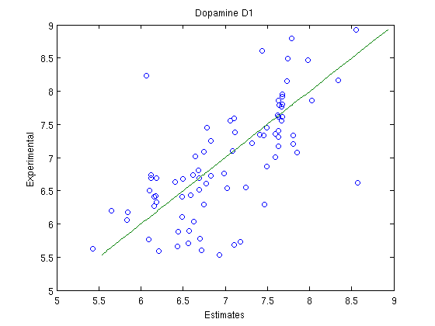
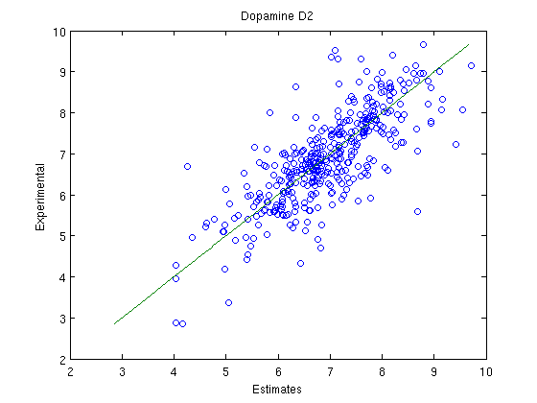
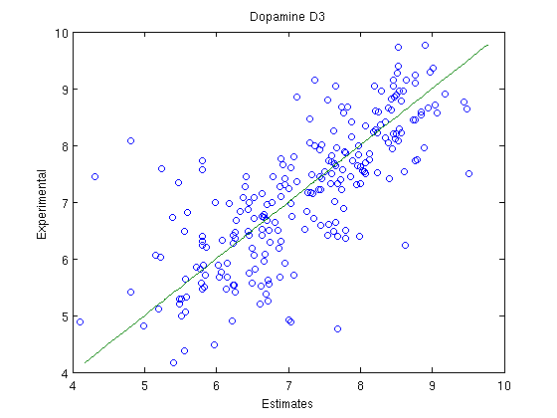
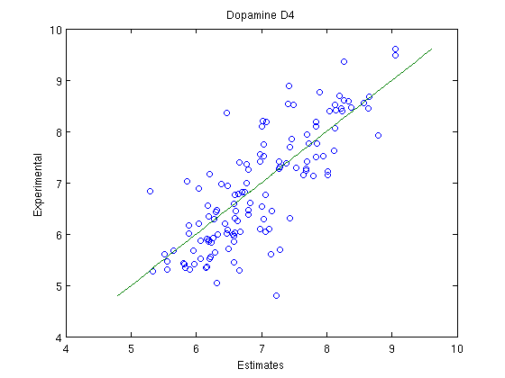
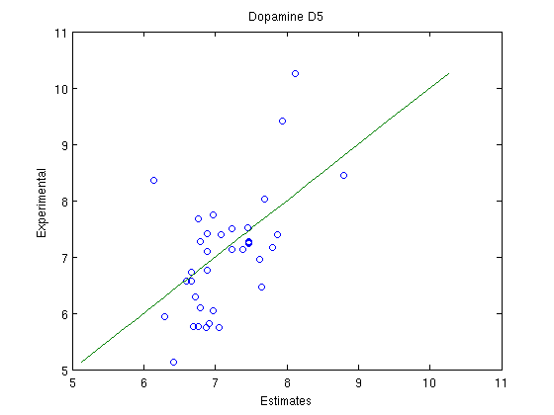
STL LASSO models for all dopamine receptors taks
D1
D2
D3
D4
D5

Slide 35
Summary
Build, apply and validate STL (LASSO) models
Automatize procedures
  STL models produced for each dopamine target
  stlRMSE: compute statistics and estimates given a model
  plotExpPred: display estimated vs experimental values scatter plots.

Slide 36
Exercise 2: The l1-norm (LASSO) MTL algorithm
Dataset
Single Task Learning (STL) / Multi-Task Learning (MTL)
Exercise 0: A brief overview of MATLAB
Exercise 1: The l₁-norm (LASSO) STL algorithm
Exercise 2: The l1-norm (LASSO) MTL algorithm
Exercise 3: Parameter optimization
Exercise 4: The l₂₁-norm MTL algorithm
Exercise 5: Benchmarking
Conclusion

Slide 37
The l₁-norm algorithm
How does it works? Minimize the objective function
Did you see this slide already?
It produces multi-linear least square regression models
with a l₁-norm regularizer

Slide 38
Matrices
D1
D2
D3
D4
D5
D1
D2
D3
D4
D5
D1
D2
D3
D4
D5
0
0
0
0
0
0
0
0
Molecules
Molecules
Descriptors
≈
×
0
0
Y
X
0
W
0
0
0
0
Descriptors
l₁-norm regularization drive some weights of the model to zero.

Slide 39
How to evaluate multiple tasks simultaneously?
Task averaged root mean squared error
Weighted task averaged root mean squared error

Slide 40
MTL models
Exo2
Copy/Paste
[W,funcval]=Least_Lasso(Xtr,Ytr,p1,opts);
Create MTL models for all dopamine targets

Slide 41
STL analysis of MTL models
Exo2
Copy/Paste
MTL_Lasso=cell(3,nDopa);
MTL_Lasso stores the models’ statistics
for t=1:nDopa
i=aDopa(t);
fprintf('**** Dopamine D%g\n',i);
[RMSE,R2,Yp]=stlRMSE(Xte{1,t},Yte{1,t},W(:,t));
MTL_Lasso{1,t}=RMSE;
MTL_Lasso{2,t}=R2;
MTL_Lasso{3,t}=Yp;
fprintf('RMSE=%g R2=%g\n',RMSE,R2);
figure;
plotExpPred(Yte{1,t},Yp,strcat('MTL Lasso Dopamine D',int2str(i)));
end
Exo2
Copy/Paste
For each task, compute and store the RMSE, the R2 and the estimates, then plot the estimates vs experimental values scatter plots.

Slide 42
STL analysis of MTL models

Slide 43
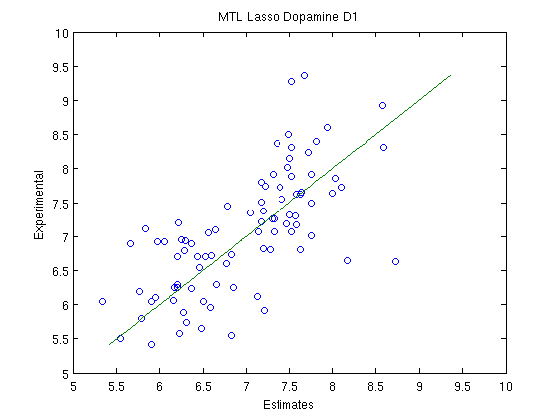
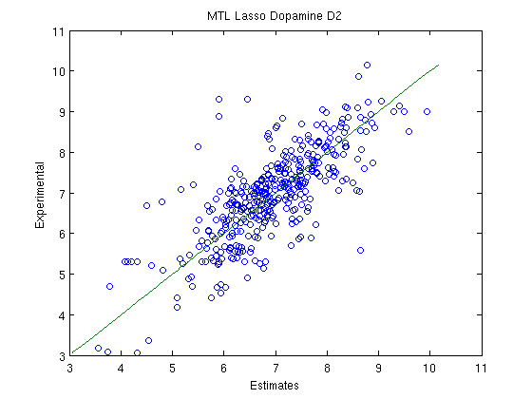
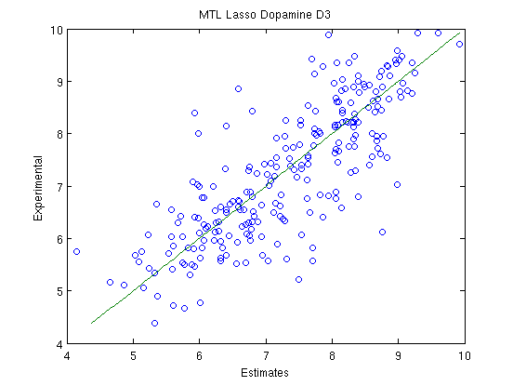
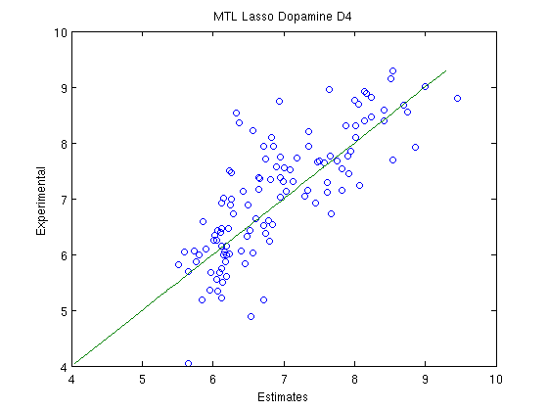
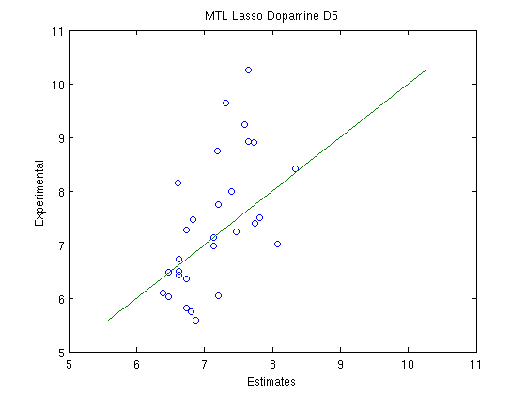
STL analysis of MTL models
D1
D2
D3
D4
D5

Slide 44
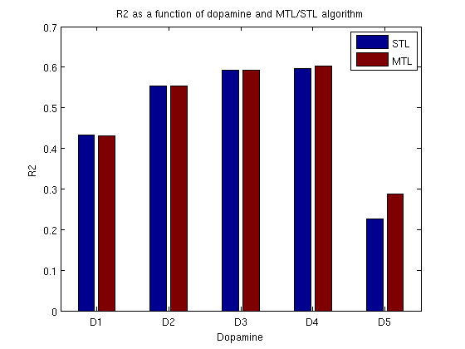
Comparison of MTL and STL models
v1=transpose(cell2mat(STL(2,:)));
v2=transpose(cell2mat(MTL_Lasso(2,:)));
figure;
bar([v1,v2]);
lDopa=transpose(arrayfun(@(x) strcat('D',int2str(x)),aDopa,'UniformOutput',false));
set(gca,'XTickLabel',lDopa);
xlabel('Dopamine');
ylabel('R2');
title('R2 as a function of dopamine and MTL/STL algorithm');
legend('STL','MTL');
Exo2
Copy/Paste
Create a bar plot comparing STL and MTL models performances

Slide 45
Multi-tasks performances of MTL models
mRMSE=mean(cell2mat(MTL_Lasso(1,:)));
wRMSE=0;
Nall=0;
for t=1:nDopa
Nt=size(Yte{1,t},1);
wRMSE=wRMSE+MTL_Lasso{1,t}*Nt;
Nall=Nall+Nt;
end
wRMSE=wRMSE/Nall;
fprintf('MTL Lasso. Mean RMSE=%g; Wght. Mean RMSE=%g\n',mRMSE,wRMSE);
Exo2
Copy/Paste
Result:
MTL Lasso. Mean RMSE=0.79; Wght. Mean RMSE=0.77

Slide 46
Multi-tasks performances of STL models
%
mRMSE=mean(cell2mat(STL(1,:)));
wRMSE=0;
Nall=0;
for t=1:nDopa
Nt=size(Yte{1,t},1);
wRMSE=wRMSE+STL{1,t}*Nt;
Nall=Nall+Nt;
end
wRMSE=wRMSE/Nall;
fprintf('STL Lasso. Mean RMSE=%g; Wght. Mean RMSE=%g\n',mRMSE,wRMSE);
Exo2
Copy/Paste
Result:
STL Lasso. Mean RMSE=0.80; Wght. Mean RMSE=0.77

Slide 47
Summary
Introduction to the l₁-norm MTL algorithm
Multi-task of models’ performances
  Task averaged root mean squared error
  Weighted task averaged root mean squared error
The sequence of STL models are equivalent to the MTL counterparts.

Slide 48
Exercise 3: Parameter optimization and parsimony
Dataset
Single Task Learning (STL) / Multi-Task Learning (MTL)
Exercise 0: A brief overview of MATLAB
Exercise 1: The l₁-norm (LASSO) STL algorithm
Exercise 2: The l₁-norm (LASSO) MTL algorithm
Exercise 3: Parameter optimization
Exercise 4: The l₂₁-norm MTL algorithm
Exercise 5: Benchmarking
Conclusion

Slide 49
CPU comparison of STL/MTL
Exo3
Copy/Paste
Nk=3; Nf=3;
t=cputime;
[rslt,mrslt]=MTL_CV1P(X,Y,'Least_Lasso',p1,opts,Nf,Nk);
e=cputime-t;
fprintf('MTL elapsed time %g\n',e);
Measure the elapsed time of 3 times 3 fold cross validation for the MTL algorithm
rslt: store models’ performances per fold
mrslt: store the performances averaged over the 3x3 folds.
Typically the MTL version of an algorithm shall be faster than the corresponding STL version.
STL=cell(1,nDopa);
t=cputime;
for t=1:nDopa
[rslt,STL{1,t}]=MTL_CV1P(X(1,t),Y(1,t),'Least_Lasso',p1,opts,Nf,Nk);
end
e=cputime-t;
fprintf('Serial STL elapsed time %g\n',e);
Exo3
Copy/Paste
Measure the elapsed time of 3 times 3 fold cross validation for the STL algorithm

Slide 50
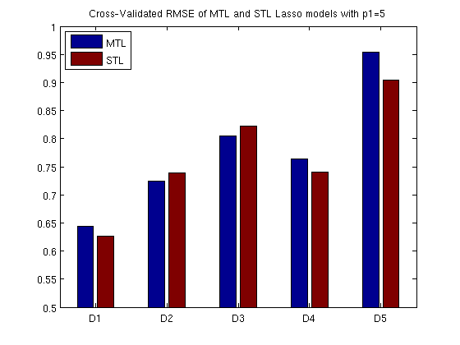
Cross-validated comparison MTL/STL
v1=transpose(mrslt{3});
v2=[];
for t=1:nDopa
v2=[v2;cell2mat(STL{t}(3))];
end
figure;
bar([v1,v2]);
ylim([0.5,1])
set(gca,'XTickLabel',lDopa);
legend('MTL','STL',2);
title('Cross-Validated RMSE of MTL and STL Lasso models with p1=5');
Exo3
Copy/Paste
Plot the cross-validated RMSE for MTL and STL models

Slide 51
Method’s parameter
The LASSO STL and l₁-norm MTL algorithm share a parameter
  The importance of the l₁-norm regularization (p1=5)
The parameter can be optimized for each task while building STL models
  There are as many parameters to optimize as there are tasks
Per task parameter tuning is impossible for MTL
  There is only one parameter to optimize

Slide 52
Parameter’s sampling
Exo3
Copy/Paste
ap1=linspace(1,100,25);
MTL_Lasso=cell(1,length(ap1));
ap1 stores a list of possible values for the parameter of the method
MTL_Lasso will store performances for each of these values
for i=1:length(ap1)
p1=ap1(i);
[rslt,mrslt]=MTL_CV1P(X,Y,'Least_Lasso',p1,opts,Nk,Nf);
MTL_Lasso{i}=mrslt;
fprintf('p1=%g; mean RMSE=%g; Wght. mean RMSE=%g\n',p1,mrslt{1},mrslt{2});
end
Exo3
Do not execute
Exo3
Copy/Paste
load('Exo3_MTL_Lasso.mat');
Cross-validate models for each sampled value of the parameter p1
Too long to be done during the tutorial’s session.

Slide 53
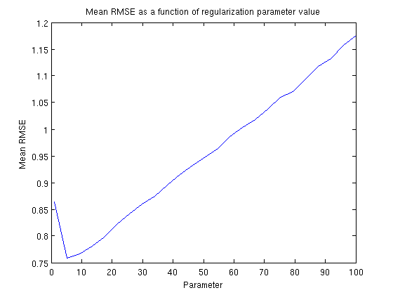
Task averaged RMSE as a function of the parameter
v3=[];
for t=1:length(ap1)
v3=[v3,cell2mat(MTL_Lasso{t}(1))];
end
figure;
plot(ap1,v3);
title('Mean RMSE as a function of regularization parameter value');
xlabel('Parameter');
ylabel('Mean RMSE');
Exo3
Copy/Paste

Slide 54
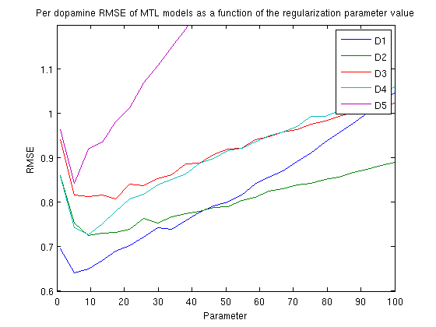
Per task RMSE as a function of the parameter
v4=[];
for t=1:length(ap1)
v4=[v4;cell2mat(MTL_Lasso{1,t}(3))];
end
figure;
plot(ap1,v4)
title('Per dopamine RMSE as a function of regularization parameter value');
xlabel('Parameter');
ylabel('RMSE');
ylim([0.6,1.2]);
legend(lDopa);
Exo3
Copy/Paste

Slide 55
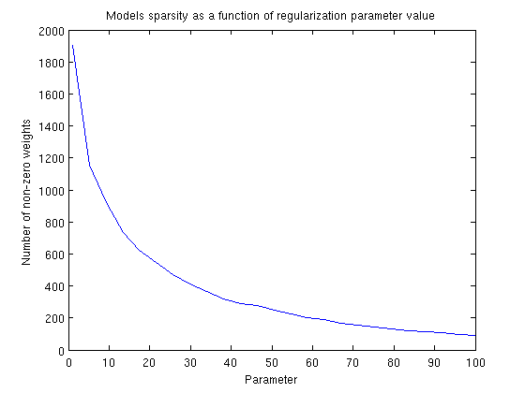
Parsimony of the models
sparsity=zeros(length(ap1));
for i=1:length(ap1)
p1=ap1(i);
[W,funcval]=Least_Lasso(X,Y,p1,opts);
sparsity(i)=nnz(W);
fprintf('p1=%g sparsity=%g\n',p1,sparsity(i));
end;
figure;
plot(ap1,sparsity)
title('Models sparsity as a function of regularization parameter value');
xlabel('Parameter');
ylabel('Number of non-zero weights');
Overfit
Underfit
Exo3
Copy/Paste
Exo3
Do not execute
load('Exo3_sparsity.mat');
Parsimony of a model is measured as the number of non-zero weigths.
Zero weights are scattered all across the weight matrix W.

Slide 56
Summary
MTL methods are usually computationally more efficient.
These algorithms produces sparse models
  Reduces the number of non-zero weights
The l₁-norm (MTL) algorithm is equivalent to the LASSO (STL) algorithm
Learning tasks are not independent in l₁-norm algorithm
  The value of the regularization parameter is common to all tasks
  This value shall be optimized for each task in the STL framework

Slide 57
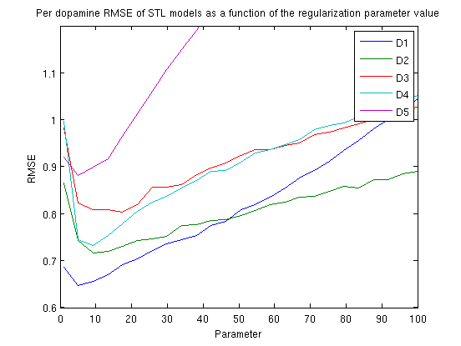
Exo3a
The Exercise folder contains a file Exo3a.m
  It is an adaptation of Exo3 to the case of STL.
  The data it produces are needed for the Exercise 5.
Exo3
Copy/Paste
load('Exo3b_sSTL.mat')
Results are very similar to the MTL case

Slide 58
Exercise 4: The l₂₁-norm MTL algorithm
Dataset
Single Task Learning (STL) / Multi-Task Learning (MTL)
Exercise 0: A brief overview of MATLAB
Exercise 1: The l₁-norm (LASSO) STL algorithm
Exercise 2: The l₁-norm (LASSO) MTL algorithm
Exercise 3: Parameter optimization
Exercise 4: The l21-norm MTL algorithm
Exercise 5: Benchmarking
Conclusion

Slide 59
The l₂₁-norm algorithm
How does it works? Minimize the objective function
Did you see this slide already?
It produces multi-linear least square regression models
with a l₂₁-norm regularizer

Slide 60
Matrices
D1
D2
D3
D4
D5
D1
D2
D3
D4
D5
D1
D2
D3
D4
D5
Molecules
Molecules
Descriptors
≈
×
Y
X
W
Descriptors
l₂₁-norm tend to put to zero whole lines of the matrix W.
Models are effectively build on a common subset of variables

Slide 61
Parameter’s sampling
Exo4
Copy/Paste
ap1=linspace(1,100,25);
MTL_L21=cell(1,length(ap1));
ap1 stores a list of possible values for the parameter of the method
MTL_L21 will store performances for each of these values
for i=1:length(ap1)
p1=ap1(i);[rslt,mrslt]=MTL_CV1P(X,Y,'Least_L21',p1,opts,Nk,Nf);
MTL_L21{i}=mrslt;
fprintf('p1=%g; mean RMSE=%g; Wght. mean RMSE=%g\n',p1,mrslt{1},mrslt{2});
end
Exo4
Do not execute
Exo4
Copy/Paste
load('Exo4_MTL_L21.mat');
Cross-validate models for each sampled value of the parameter p1
Too long to be done during the tutorial’s session.

Slide 62
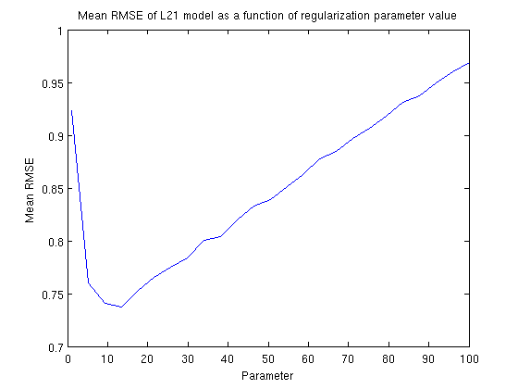
Task averaged RMSE as a function of the parameter
v5=[];
for t=1:length(ap1)
v5=[v5,cell2mat(MTL_L21{t}(1))];
end
figure;
plot(ap1,v5);
title('Mean RMSE of L21 model as a function of regularization parameter value');
xlabel('Parameter');
ylabel('Mean RMSE');
Exo4
Copy/Paste

Slide 63
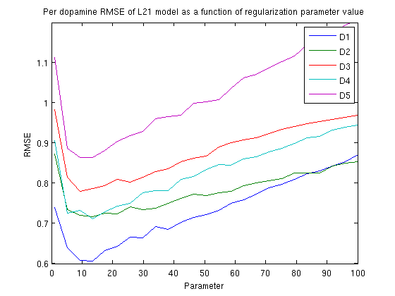
Per task RMSE as a function of the parameter
v6=[];
for t=1:length(ap1);
v6=[v6;cell2mat(MTL_L21{t}(3))];
end
figure;
plot(ap1,v6)
title('Per dopamine RMSE of L21 model as a function of regularization parameter value');
xlabel('Parameter');
ylabel('RMSE');
legend(lDopa);
Exo4
Copy/Paste

Slide 64
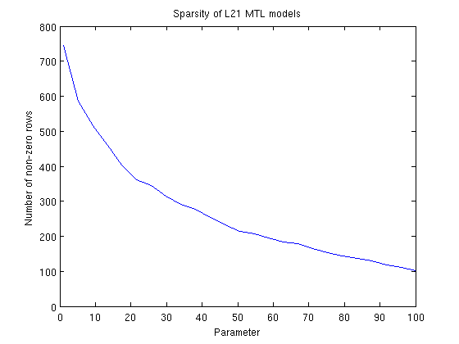
Parsimony of the models
sparsity_L21=zeros(length(ap1));
for i=1:length(ap1)
p1=ap1(i);
[W,funcval]=Least_L21(X,Y,p1,opts);
sparsity_L21(i)=nnz(sum(W,2));
end
figure;
plot(ap1,sparsity_L21);
title('Sparsity of L21 MTL models');
xlabel('Parameter');
ylabel('Number of non-zero rows');
Overfit
Underfit
Exo4
Do not execute
Exo4
Copy/Paste
load('Exo4_sparsity_L21.mat');
Parsimony of a model is measured as the number of non-zero weigths.
Zeros are concentrated on the same lines.
The graph measure the number of non-zero rows.

Slide 65
Summary
The l₂₁-norm MTL algorithm is another variation of the LASSO algorithm
  Differ on the calculation of the norm of the matrix weight
The l₂₁-norm implement much more interference between learning tasks
  Tasks are related because they share a common subset of descriptors

Slide 66
Exercise 5: Benchmarking
Dataset
Single Task Learning (STL) / Multi-Task Learning (MTL)
Exercise 0: A brief overview of MATLAB
Exercise 1: The l₁-norm (LASSO) STL algorithm
Exercise 2: The l₁-norm (LASSO) MTL algorithm
Exercise 3: Parameter optimization
Exercise 4: The l21-norm MTL algorithm
Exercise 5: Benchmarking
Conclusion

Slide 67
Optimization of algorithm parameter
It is possible to sample the parameter values like in previous exercises
The problem is convex, noisy and 1D
  A good candidate is dichotomy search
  More generally, the Nelder-Mead is one of the best candidate to do the job.

Slide 68
Dichotomy
CVE(p5)
CVE(p1)
CVE(p4)
Cross-validated RMSE
CVE(p3)
CVE(p2)
p1
p2
p3
p4
p5
Parameter value
The optimal value and the two neighbor samples of the parameter values define the range of the search for the next iteration
The initialization requires the sampling of 5 values

Slide 69
Dichotomy
CVE(p1)
Cross-validated RMSE
CVE(p2)
CVE(p5)
CVE(p3)
CVE(p4)
p1
p2
p3
p4
p5
Parameter value
Remarks:
It is useless/detrimental to optimize too precisely the parameter value
3 or 4 iterations are sufficient

Slide 70
Optimizing MTL LASSO and l₂₁-norm
Exo5
Copy/Paste
pmin=1;
pmax=50;
Nf=3;
Nk=3;
maxiter=3;
Define the parameters of the cross-validation and of the parameter search
Exo5
Do not execute
[p_Lasso,val_Lasso]=DichotomyOptimize(X,Y,'Least_Lasso',opts,pmin,pmax,Nf,Nk,maxiter);
[p_L21,val_L21]=DichotomyOptimize(X,Y,'Least_L21',opts,pmin,pmax,Nf,Nk,maxiter);
Exo5
Copy/Paste
load('Exo5_p_Lasso.mat');
load('Exo5_p_L21.mat');
p_Lasso, p_l21 store the optimal value of the parameter
val_Lasso, val_l21 store the corresponding task averaged RMSE

Slide 71
Optimizing STL LASSO
Exo5
Copy/Paste
p_STL=cell(2,nDopa);
p_STL shall store optimal parameter value and task averaged RMSE for each task.
Exo5
Do not execute
Exo5
Copy/Paste
for t=1:nDopa
[p_STL{1,t},p_STL{2,t}]=DichotomyOptimize(X(1,t),Y(1,t),'Least_Lasso',opts,pmin,pmax,Nf,Nk,maxiter);
end;
load('Exo5_p_STL.mat');

Slide 72
Learning together related tasks
Dopamine receptors can be divided into two groups
  D1 and D5
  D2, D3 and D4
It might be a good idea to develop MTL models separately
  One MTL D1, D5
  One MTL D2, D3, D4

Slide 73
Two subsets MTL models
Exo5
Copy/Paste
X15=cell(1,2);
X15(1,1)=X(1,1); X15(1,2)=X(1,5);
X234=cell(1,3);
X234(1,1)=X(1,2); X234(1,2)=X(1,3); X234(1,3)=X(1,4);
Create two set of molecular descriptors matrices (D1,D5) and (D2, D3, D4).
Exo5
Copy/Paste
Y15=cell(1,2);
Y15(1,1)=Y(1,1); Y15(1,2)=Y(1,5);
Y234=cell(1,3);
Y234(1,1)=Y(1,2); Y234(1,2)=Y(1,3); Y234(1,3)=Y(1,4);
Create two set of property matrices (D1,D5) and (D2, D3, D4).

Slide 74
Prepare D1,D5 and D2, D3, D4
[p_Lasso_15,val_Lasso_15]=DichotomyOptimize(X15,Y15,'Least_Lasso',opts,pmin,pma
x,Nf,Nk,maxiter);
[p_L21_15,val_L21_15]=DichotomyOptimize(X15,Y15,'Least_L21',opts,pmin,pmax,Nf,N
k,maxiter);
Exo5
Do not execute
Exo5
Copy/Paste
load('Exo5_p_Lasso_15.mat');
load('Exo5_p_L21_15.mat');
Exo5
Do not execute
Exo5
Copy/Paste
[p_Lasso_234,val_Lasso_234]=DichotomyOptimize(X234,Y234,'Least_Lasso',opts,pmin,pmax,Nf,Nk,maxiter);
[p_L21_234,val_Lasso_234]=DichotomyOptimize(X234,Y234,'Least_L21',opts,pmin,pmax,Nf,Nk,maxiter);
load('Exo5_p_Lasso_234.mat');
load('Exo5_p_L21_234.mat');

Slide 75
Benchmarking
[rslt,m_Lasso]=MTL_CV1P(X,Y,'Least_Lasso',p_Lasso,opts,Nf,Nk);
%[rslt,m_L21]=MTL_CV1P(X,Y,'Least_L21',p_L21,opts,Nf,Nk);
[rslt,m_Lasso_15]=MTL_CV1P(X15,Y15,'Least_Lasso',p_Lasso_15,opts,Nf,Nk);
[rslt,m_L21_15]=MTL_CV1P(X15,Y15,'Least_L21',p_L21_15,opts,Nf,Nk);
[rslt,m_Lasso_234]=MTL_CV1P(X234,Y234,'Least_Lasso',p_Lasso_234,opts,Nf,Nk);
[rslt,m_L21_234]=MTL_CV1P(X234,Y234,'Least_L21',p_L21_234,opts,Nf,Nk);
load('Exo5_m_Lasso.mat');
load('Exo5_m_L21.mat');
load('Exo5_m_Lasso_15.mat');
load('Exo5_m_L21_15.mat');
load('Exo5_m_Lasso_234.mat');
load('Exo5_m_L21_234.mat');
Exo5
Do not execute
Exo5
Copy/Paste
Using the optimal parameter value for each method and each cases, compute the predictive performances in cross-validation.
Exo5
Copy/Paste
m_STL=cell(1,nDopa);
for t=1:nDopa
[rslt,m_STL{1,t}]=MTL_CV1P(X(1,t),Y(1,t),'Least_Lasso',p_STL{1,t},opts,Nf,Nk);
end;

Slide 76
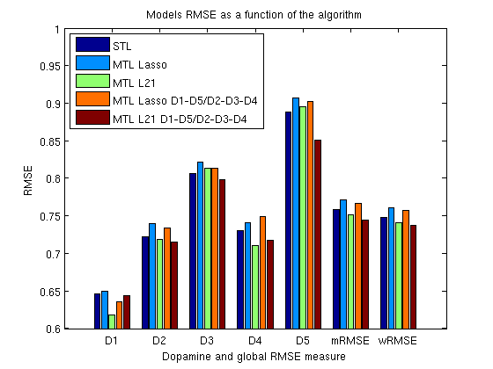
Benchmarking
%
aa=[];
for t=1:nDopa
aa=[aa,cell2mat(m_STL{1,t}(1))];
end;
mRMSE=mean(aa);
wRMSE=0;
Nall=0;
for t=1:nDopa
Nt=size(Yte{1,t},1);
wRMSE=wRMSE+aa(t)*Nt;
Nall=Nall+Nt;
end
wRMSE=wRMSE/Nall;
fprintf('STL Lasso. Mean RMSE=%g Wght. Mean RMSE=%g\n',mRMSE,wRMSE);
aa=[aa,mRMSE,wRMSE];
aa_Lasso=[m_Lasso{1,3},m_Lasso{1,1},m_Lasso{1,2}];
aa_L21=[m_L21{1,3},m_L21{1,1},m_L21{1,2}];
bb15=m_Lasso_15{1,3};
bb234=m_Lasso_234{1,3};
aa_Lasso_15_234=[bb15(1),bb234(1),bb234(2),bb234(3),bb15(2)];
mRMSE=mean(aa_Lasso_15_234);
wRMSE=0;
Nall=0;
for t=1:nDopa
Nt=size(Yte{1,t},1);
wRMSE=wRMSE+aa_Lasso_15_234(t)*Nt;
Nall=Nall+Nt;
end
wRMSE=wRMSE/Nall;
fprintf('STL Lasso. Mean RMSE=%g Wght. Mean RMSE=%g\n',mRMSE,wRMSE);
aa_Lasso_15_234=[aa_Lasso_15_234,mRMSE,wRMSE];
%
bb15=m_L21_15{1,3};
bb234=m_L21_234{1,3};
aa_L21_15_234=[bb15(1),bb234(1),bb234(2),bb234(3),bb15(2)];
mRMSE=mean(aa_L21_15_234);
wRMSE=0;
Nall=0;
for t=1:nDopa
Nt=size(Yte{1,t},1);
wRMSE=wRMSE+aa_L21_15_234(t)*Nt;
Nall=Nall+Nt;
end
wRMSE=wRMSE/Nall;
fprintf('STL Lasso. Mean RMSE=%g Wght. Mean RMSE=%g\n',mRMSE,wRMSE);
aa_L21_15_234=[aa_L21_15_234,mRMSE,wRMSE];
%
figure;
bar(transpose([aa;aa_Lasso;aa_L21;aa_Lasso_15_234;aa_L21_15_234]));
lBars=[lDopa;'mRMSE';'wRMSE'];
set(gca,'XTickLabel',lBars);
title('Models RMSE as a function of the algorithm');
xlabel('Dopamine and global RMSE measure');
ylabel('RMSE');
legend('STL','MTL Lasso','MTL L21','MTL Lasso D1-D5/D2-D3-D4','MTL L21 D1-D5/D2-D3-D4',2);
ylim([0.6,1]);
%
Recover cross-validate statistics for all experiments and draw them in a nice plot
Exo5
Copy/Paste

Slide 77
Summary
Gross optimization of the parameter of the method is sufficient
  A few steps (3 or 4) of dichotomy algorithm is usually sufficient.
In a benchmarking study, the l21-norm MTL algorithm appears a bit superior
  It is really superior for D5 if learned with D1
The inductive transfer is possible between related tasks
  In this context, related tasks share a common subset of descriptors

Slide 78
Conclusion
Dataset
Single Task Learning (STL) / Multi-Task Learning (MTL)
Exercise 0: A brief overview of MATLAB
Exercise 1: The l₁-norm (LASSO) STL algorithm
Exercise 2: The l₁-norm (LASSO) MTL algorithm
Exercise 3: Parameter optimization
Exercise 4: The l21-norm MTL algorithm
Exercise 5: Benchmarking
Conclusion

Slide 79
Conclusion
What is Multi-task leaning?
  A class of algorithm that produces simultaneously multiple models
  Learning tasks shall interfere in order to benefit of possible inductive transfer.
Is it useful?
  Globally, these algorithms are more efficient and easier to manage than the corresponding number of single tasks learning

Slide 80
Conclusion
How does it validate?
  A sequence of STL or an MTL validate using generalizations of RMSE
    Task averaged RMSE
    Weighted task averaged RMSE
Is it better?
  Not always.
    It can be detrimental too

Slide 81
Conclusion
When does it work?
  When the assumptions concerning the relatedness of tasks are approximately true
What does it means that tasks are related?
  In the l1-norm context, they should share the same optimal value of the regularization parameter
  In the l21-norm context, they should share the same subspace of relevant descriptors
How do I know a priori that tasks are related?
  You shall rely on the scientific context
    The biological knowledge on the dopamine receptor family

Slide 82
Perspectives
There are plenty of MTL algorithm
  19 in MALSAR for regression, classification and clustering
  Differences on regularization, structure of the tasks relation-ship, in tasks communications
MTL algorithms are under-developed
  Need new open source implementations to help the community decide to use them or not
There are other ways to develop inductive transfer
  Feature nets
Task relatedness is misterious
  There exists also anti-relatedness

Slide 83

Thank you for your sweat

