Slide 1
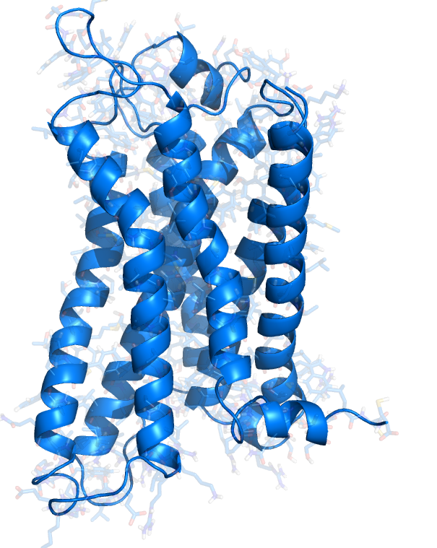


Designing, synthesising and testing peptide probes of receptor function: Investigating the Apelin GPCR
Robert C. Glen, Max Macaluso, Anthony Davenport, Zhi Wang

Slide 2
Translation from design to the clinic
Modelling – stucture- and pharmacophore-based
Peptide design
Small molecule discovery
Receptor affinity/2nd messenger screening
Functional assays
Human tissue
B-arrestin signalling
Chemistry Dept. Cambridge
Cambridge Peptides
CEREP Paris
BHF Clinical
Pharmacology group
Ethical approval
Human Forearm study
Peptide synthesis to GLP
Pyrogenic testing
Asceptic prep
Dosing vials
Intact heart (rat)
Monocrotylene rat (PAH)
Addenbrookes Hospital
Grant/Outsourced
Synthesis Cambridge

Slide 3
Generating Pharmacologically relevant leads
Natural leads
Complexity of Disease
Screening
Lead compounds
Rational design
Identified Target(s)
Similarly, we can discover/design compounds for a target, or have compounds (or materials) looking for a target
Re-purposing drugs
We may have a disease in mind and be looking for a target or,
we may have a target and be looking for a suitable disease.
Or, the biology may be interesting to probe
Mimetics
Mixtures....

Slide 4
apelin
apelin
-
13
Q
R
P
R
L
S
H
K
G
P
M
P
F
Apelin is the endogenous ligand for the G-protein-coupled APJ receptor. It is widely expressed in various organs such as the heart, lung, kidney, liver, adipose tissue, gastrointestinal tract, brain, adrenal glands, endothelium, and blood.
The apelin (APLN) gene encodes a 77 amino acids peptide with a signal peptide in the N-terminal region. After translocation into the endoplasmic reticulum and cleavage of the signal peptide, a 55 amino acids fragment can generate several active fragments:
a 36 amino acid peptide corresponding to the sequence 42-77 (apelin-36)
a 17 amino acid peptide corresponding to the sequence 61-77 (apelin-17)
a 13 amino acid peptide corresponding to the sequence 65-77 (apelin-13)
Apelin-13 may also undergo a pyroglutamination at the N-terminal glutamine residue.
Apelin-13 is a potent agonist at the APJ receptor
[¹²⁵I]-(Pyr1)apelin-13 (human lung), K_{D}=0.4 nM
O'Dowd BF, Heiber M, Chan A, Heng HH, Tsui LC, Kennedy JL, Shi X, Petronis A, George SR, Nguyen T (December 1993). "A human gene that shows identity with the gene encoding the angiotensin receptor is located on chromosome 11". Gene 136 (1-2): 355–60.
Tatemoto K, Hosoya M, Habata Y, Fujii R, Kakegawa T, Zou MX, Kawamata Y, Fukusumi S, Hinuma S, Kitada C, Kurokawa T, Onda H, Fujino M (1998). "Isolation and characterization of a novel endogenous peptide ligand for the human APJ receptor". Biochem. Biophys. Res. Commun. 251 (2): 471–6.

Slide 5
What does apelin do?
Vascular
participates in the control of blood pressure
promotes the formation of new blood vessels (angiogenesis)
Cardiac
In cardiomyocytes apelin behaves as one of the most potent stimulators of cardiac contractility
Involved in the embryonic formation of the heart
plays a role in cardiac tissue remodeling
circulating levels of apelin are higher in obesity
Brain
apelin regulates fluid homeostasis via hypothalamic regulation of food and water intake
Digestive/Metabolic
Involvement in acid secretion
Inhibits glucose secretion
Involved in glucose uptake and control of glycemia
Bone
Involved in bone formation via osteoblasts, the cell progenitors involved in bone formation
Immune system
APJ is a co-receptor for HIV
Kleinz MJ, Davenport AP (2005). "Emerging roles of apelin in biology and medicine". Pharmacol. Ther. 107 (2): 198–211.

Slide 6
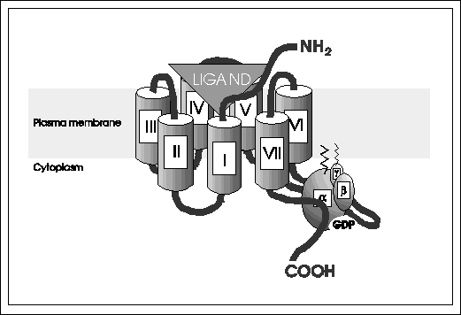
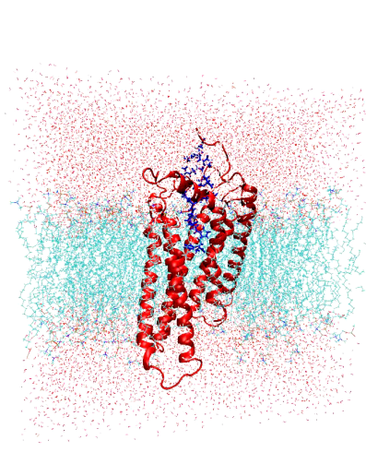
A GPCR is made up of 7-transmembrane helixes
Apelin acts at the “APJ” G-protein coupled receptor
When a ligand binds to the GPCR it causes a conformational change in the GPCR, which allows it to act as a guanine nucleotide exchange factor (GEF). The GPCR can then activate an associated G-protein by exchanging its bound GDP for a GTP. The G-protein's α subunit, together with the bound GTP, can then dissociate from the β and γ subunits to further affect intracellular signaling proteins or target functional proteins directly depending on the α subunit type . But there may be more........

Slide 7
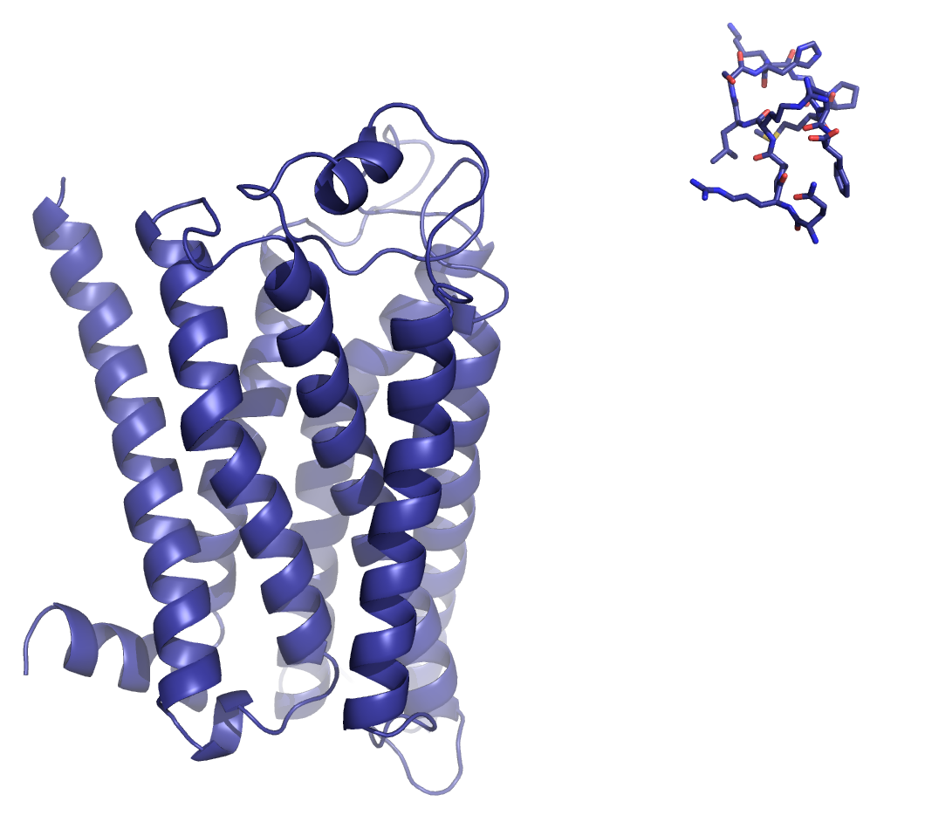

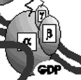
Biased agonism – a new emerging concept in GPCR pharmacology
2nd messenger
pathway
β-arrestin pathway
G protein signalling
Rapid onset
Desensitisation
2nd messenger
Arr
Arrestin signalling
Slower onset
Sustained duration
Signalsome-dependent
Response
AC
PLCβ
Ion channel
TK
MAPK
E3 Ligase
G protein dependent
signalling
Arrestin-Dependent signalling
Seconds-minutes
Minutes-hours
Beyond Desentization: Physiological Relevance of Arrestin-Dependent Signalling. Louis M. Luttrell and Diane Gesty-Palmer. Pharmacologicl Reviews, 62:305-330, 2010.

Slide 8
Biased agonism – a new emerging concept in GPCR pharmacology
2nd messenger
pathway
β-arrestin pathway
G protein signalling
Rapid onset
Desensitisation
2nd messenger
Arr
Arrestin signalling
Slower onset
Sustained duration
Signalsome-dependent
Response
AC
PLCβ
Ion channel
TK
MAPK
E3 Ligase
G protein dependent
signalling
Arrestin-Dependent signalling
Seconds-minutes
Minutes-hours
New class of drugs?
Beyond Desentization: Physiological Relevance of Arrestin-Dependent Signalling. Louis M. Luttrell and Diane Gesty-Palmer. Pharmacologicl Reviews, 62:305-330, 2010.

Slide 9
Apelin-APJ System
APJ Receptor
Apelin-13
A conformationally complex peptide which binds and activates the receptor by stabilising an ‘agonist’ conformation
Where do we start?

Slide 10
Peptides are difficult to analyse...so
We find the smallest active peptide fragment
Identify side chain roles - and investigate these
Conformationally constrict linear structures
Analyse/optimise putative pharmacophores and plasma stability (if we are in-vivo)
Why not just get a small molecule mimic? There are some advantages to peptides:-
The endogenous peptide is an easy starting point for analoging
Natural AA peptides are easier to clinically trial as experimental pharmacological probes – big advantage
Easy to synthesise (in general) – can make many analogs
High selectivity and usually low toxicity – like food (but lets not talk about snake venoms...)

Slide 11
Combination of ligand-based and receptor-based design with
access to ethically sourced human tissue
Alanine scanning
Cyclic peptide design
Affinity screening
NMR/Simulation and analysis
Re-design
Pharmacophore detection
Homology model of APJ
Analysis of putative binding regions
Human diseased/normal tissue
Small molecule virtual screening
Receptor screening
ß-receptor /AT1 insights
Hypothesis generation
Human in-vivo studies

Slide 12
Reported apelin analogs
Apelin
Q
R
P
R
L
S
H
K
G
P
M
P
F
R
P
R
L
S
H
K
G
P
M
P
F
Hamada et al.
agonists
R
P
R
L
S
H
K
G
P
M
P
F
R
P
R
L
S
H
K
G
P
M
P
F
Int J Mol Med. 2008 Oct;22(4):547-52.
Agonist in assays we’ve tried (iliac artery, LANCE, cardiac tissue)
Q
R
P
R
L
S
H
K
G
P
M
P
A
O’Dowd et al.
Agonist/
Functional Antagonist ?
Endocrinology. 2005 Jan;146(1):231-6. Epub 2004 Oct 14.
Recently, the first non-peptide APJ agonist was reported by GPCR-focused library screening
Iturrioz et al. FASEB J. 2009 Dec 29.

Slide 13
Using alanine scanning data
The replacement of amino acids with alanine can highlight important residues necessary for binding – replacement of these should be avoided to keep affinity
Even small peptides like apelin can explore an enormous range of conformations
In order to restrict conformational space and identify putative ligand-bound conformations, cyclisation of key regions of the peptide is helpful
Cyclic analogs showing binding affinity (presumably) adopt a reasonable conformation for binding
NMR analysis of the cyclic peptide in combination with simulation can narrow down the allowed conformational space

Slide 14
Alanine scanning
Binding activity of alanine scanning apelin-13 peptides.
The APJ stably expressing 293 cells were incubated with [125I]apelin-13 (0.2 nM) in the presence of increasing
concentrations of cold apelin-13 or apelin-36, and cell-associated radioactivity was counted with gamma-emissions.
Xuejun Fan, Naiming Zhou, Xiaoling Zhang, Muhammad Mukhtar,Zhixian Lu, Jianhua Fang, Garrett C. DuBois and Roger J. Pomerantz. Biochemistry 2003, 42, 10163-10168.
apelin-13 (IC₅₀ ) 0.7 nM)

Slide 15
Alanine scanning
Binding activity of alanine scanning apelin-13 peptides.
The APJ stably expressing 293 cells were incubated with [125I]apelin-13 (0.2 nM) in the presence of increasing
concentrations of cold apelin-13 or apelin-36, and cell-associated radioactivity was counted with gamma-emissions.
Xuejun Fan, Naiming Zhou, Xiaoling Zhang, Muhammad Mukhtar,Zhixian Lu, Jianhua Fang, Garrett C. DuBois and Roger J. Pomerantz. Biochemistry 2003, 42, 10163-10168.
apelin-13 (IC₅₀ ) 0.7 nM)
Note that in some cases, there is a profound effect of replacement, and in others
little effect on binding affinity. Of course, the effects of replacement change a number of factors including conformation (global) and available binding groups (local)

Slide 16
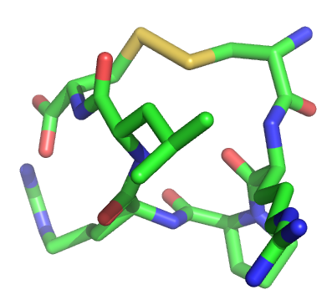
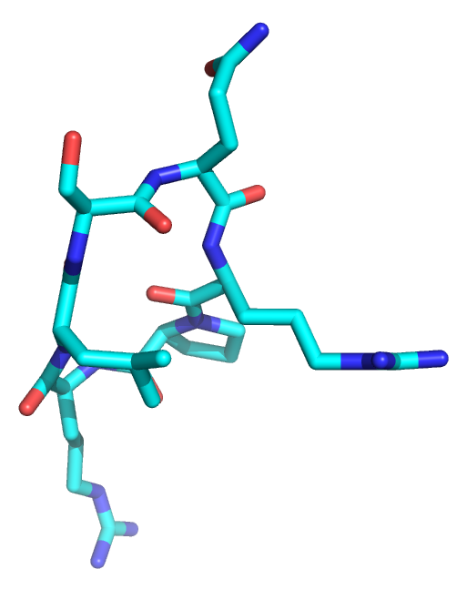
Cyclisation
Disulfide bridge
Cysteine replacement
terminal NH₂ and COOH
Can add additional polypeptide
chains
Can functionalise the terminae
Head to tail cyclisation
Maintain sequence
Lose terminal NH₂ and COOH
More difficult to add
polypeptide chains
Amide bond

Slide 17
Cyclic Peptide Design head to tail cyclisation – focusing on the RPRL motif
Q
R
P
R
L
S
H
K
G
P
M
P
F
Q
R
P
R
L
S
% inhib. Pyr-apelin-13,
Human recombinant
CHO cells
57 % inhibition
Q
R
P
R
L
S
H
62 % inhibition
Q
R
P
R
L
S
H
K
No affinity
Why?
Q
R
P
R
L
S
H
K
G
No affinity

Slide 18
Replica Exchange Molecular Dynamics
Each peptide was placed in a periodic cubic box (3.97 nm³), solvated with TIP3P waters, and minimized in Gromacs version 3.3.1. Chloride ions were added to neutralize the total system charges.
Water molecules were first equilibrated at each temperature for 200 ps and each replica starting system was equilibrated at its respective temperature for 1 ns. Production runs then permitted swaps between adjacent replicas every 2.0 ps and coordinates from the trajectory were saved every 0.5 ps. The simulations were run at the NPT ensemble with constant pressure (1 bar) and temperature maintained with the Berendsen barostat and thermostat, respectively.
Peptide | No. peptide Atoms | No. water molecules | No. Cl- ions | Total no. atoms | Initial Simulation cell dimensions (nm³) | Ave. exchange probabilities (%)
1 | 109 | 2049 | 2 | 6258 | 3.97 | 29.2
2 | 126 | 2049 | 2 | 6275 | 3.97 | 29.7
3 | 148 | 2042 | 3 | 6277 | 3.97 | 29.6
4 | 155 | 2008 | 3 | 6182 | 3.97 | 29.7
Peptide | Sequence | RPRL intra-turn hydrogen bond (% of conformations) | RLSH intra-turn hydrogen bond (% of conformations)
1 | Cyclo(1-6)QRPRLS | 82.3 | -
2 | Cyclo(1-7)QRPRLSH | 63.5 | 3.0
3 | Cyclo(1-8)QRPRLSHK | 0 | 78.5
4 | Cyclo(1-9)QRPRLSHKG | 1.3 | 49.7

Slide 19
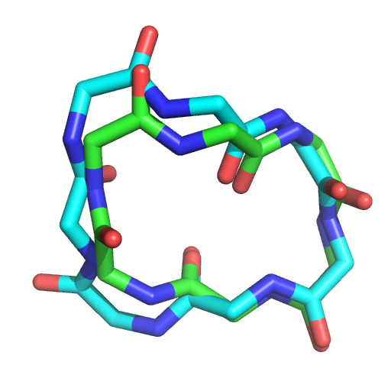
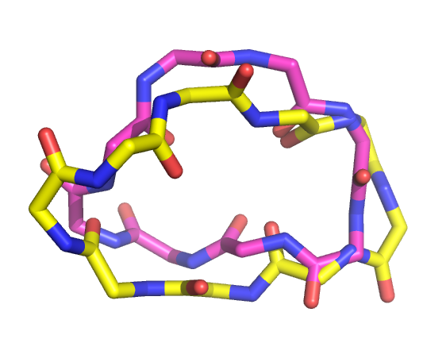
A common feature among the active peptides was a β-turn at ‘RPRL’
Arg4
Arg2
Leu5
Pro3
Ser6
Arg4
His7
Leu5
RPRL β-turn in 5-13% of simulation
(RLSH-turn preferred)
No binding at APJ
RPRL β-turn in 92-100% of simulation
Moderate binding at APJ
So, the RPRL motif and a β-turn seems to be important for binding affinity,
But of course, that is not the sole requirement.
Exploring the RPRL Motif of Apelin-13 through Molecular Simulation and Biological Evaluation of Cyclic Peptide Analogues
N. J. Maximilian Macaluso, Robert C. Glen. ChemMedChem, 2010, 5(8), 1247-1253.

Slide 20
NOE Constraints / cyclo(1-6)CRPRLC
Proton Correlation | NOE strength | (Å)
c - a | strong | 1.5 - 2.8
c - a' | medium | 2.8 - 3.5
c - e | medium | 2.8 - 3.5
c - e' | medium | 2.8 - 3.5
c - b | strong | 1.5 - 2.8
g - i | weak | 3.5 - 5.0
g - e | weak | 3.5 - 5.0
g - h | strong | 1.5 - 2.8
g - f | strong | 1.5 - 2.8
j - h | strong | 1.5 - 2.8
l - a | medium | 2.8 - 3.5
l - a' | weak | 3.5 - 5.0
l - h | medium | 2.8 - 3.5
l - f | medium | 2.8 - 3.5
l - k | strong | 1.5 - 2.8
g - j | strong | 1.5 - 2.8
j - l | strong | 1.5 - 2.8
m - a' | weak | 3.5 - 5.0
Gives quite a good set of constraints to model the
cyclic backbone (and compare to replica exchange molecular dynamics), but the arginine sidechains are very flexible. A β-turn is probable in the RPRL motif.
Conformation
(nmr by Paul Sanderson, Unilever Colworth)

Slide 21
Cyclic Peptide Design II investigate more about apelin binding
Q
R
P
R
L
S
H
K
G
P
M
P
F
% inhib. Pyr-apelin-13,
Human recombinant
CHO cells
C
R
P
R
L
C
18 % inhibition
98 % inhibition
(K_{i} 270nM)
C
R
P
R
L
C
H
K
G
P
M
P
F
H
K
G
P
M
P
F
4 % inhibition
Put in the rest of the sequence.....significant binding affinity in human recombinant CHO assay. It looks like the cyclisation is well tolerated – and could introduce interesting pharmacology. Any similarities with apelin-13 conformations in solution? What does the head and tail do?

Slide 22
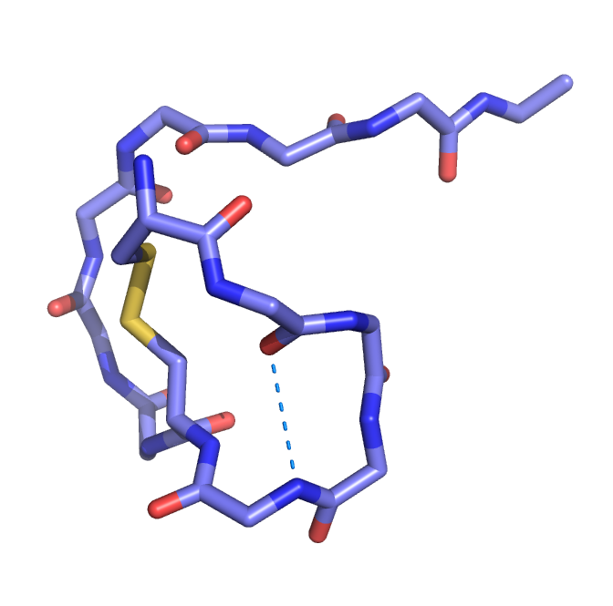
Simulating cyclic apelin analogs
Cyclo(1-6)CRPRLCHKGPMPF was simulated using replica exchange molecular dynamics (Gromacs 3.3.1, OPLS-AA/TIP3P) as before, with Apelin-13.
Simulation for 20ns + 100 ns
Analysis revealed a β-turn at the RPRL motif in 97% of the sampled data (consistent with nmr of the small cyclic fragment).
C
R
P
R
L
C
H
K
G
P
M
P
F
Also, see Rainey et al. Biochemistry, 2009, 48 (3), pp 537–548

Slide 23
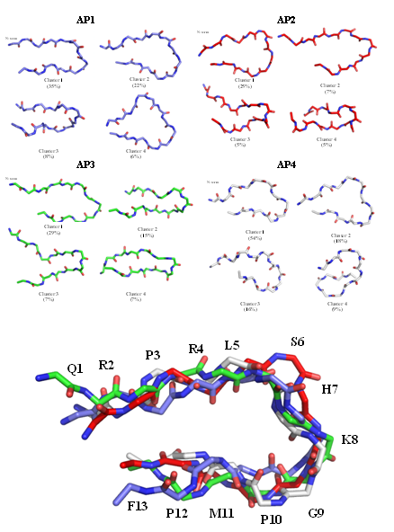
Molecular Dynamics simulation of Apelin-13
In solution
(Replica-exchange molecular dynamics method for protein folding. Chemical Physics Letters 1999;314:141-51)
Note the ‘U’ shaped fold in solution. Explores the β-turn , but no stable β-turn at RPRL in solution simulations
This suggest a cyclic analogue, stabilising the fold by cysteine replacements.

Slide 24
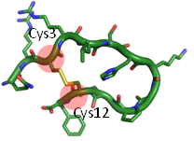

Despite a much lower binding affinity, this compound shows a higher efficacy, inducing
a ‘super agonist’ effect – greater stimulation than apelin itself – interesting...also, note
It’s in human tissue.
 | CHO-K1-APJ cells^{[a]} |  |  | Human left ventricle | cAMP accumulation in CHO-K1-APJ cells^{[c]}
Compound | % inhibition | IC₅₀ (nM) | K_{i} (nM) | K_{D} (nM)^{[b]} | pD2 | Emax
(Pyr¹)apelin-13 | - | 0.64 | 0.56 | 12.2 ± 2.78 | 9.3 | 100
Analogue | 86 | 570 | 500 | 247 ± 38.6 | 5.5 | 153
Is this evidence that this compound is a biased agonist? See later.

Slide 25
Generating a pharmacophore
Pharmacophores, if constructed with care, often work very well – it’s a generalisation that allows ‘scaffold hopping’. I like pharmacophores.
These peptides are conformationally labile, and therefore a simple overlay is not possible
We took the approach of generating a series of cyclic analogues, constrained in different ways, screening these for binding affinity and relating affinity to the solution structure from MD simulations.
We used the approach of quasi-dynamic pharmacophores – essentially overlaying the density of different preferred conformations and looking for consistency
Binders have common desired features
Non-binders help eliminate features
Mallik B, Morikis D. Development of a quasi-dynamic pharmacophore model for anti-complement peptide analogues. Journal of the American Chemical Society 2005;127:10967-76.
Bernard D, Coop A, MacKerell AD. 2D conformationally sampled pharmacophore: A ligand-based pharmacophore to differentiate delta opioid agonists from antagonists. Journal of the American Chemical Society 2003;125:3101-7.

Slide 26
Analogues were synthesised and tested to examine:
The requirement for a β-turn at RPRL
Comparison with the solution-phase conformation
Investigation of cycle size
Cysteine vs. Head to tail
Replacement of residues with lysine and alanine
Stereochemistry at the arginine residues
Peptide | Sequence | % inhibition^{[a]} | % RPRL β-turn^{[b]}
1 | Cyclo(1-6)CRPRLCHKGPMPF | 98 | 97
2 | Cyclo(3-12)QRCRLSHKGPMCF | 86 | 0
3 | Cyclo(1-6)QRPRLS^{[c]} | 57 | 100
4 | Cyclo(1-6)QRPKLS | 59 | 100
5 | Cyclo(1-7)QRPRLSH^{[c]} | 62 | 97.9
6 | QRPRLS | 28 | 32.8
7 | QRPRLSH | 23 | 28.4
8 | Cyclo(1-8)QRPRLSHK^{[c]} | 5 | 8.6
9 | Cyclo(1-9)QRPRLSHKG^{[c]} | 9 | 17.8
10 | Cyclo(1-6)CRPRLC | 18 | 92.8
11 | Cyclo(1-7)CRPRLSC | 13 | 14.5
12 | Cyclo(1-6)CRPKLC | 44 | 86.2
13 | Cyclo(1-6)CKPRLC | 0 | 86.2
14 | Cyclo(1-6)QRPRIS | 0 | 100
15 | Cyclo(1-6)Q-D-R-PRLS | 0 | 54.4
16 | Cyclo(1-6)QRP-D-R-LS | 0 | 99.3
17 | Cyclo(1-7)ARPRLSA | 11 | 80.4
Affinity not solely due to the β-turn content (of course) but is a major contributor, where the required pharmacophore interactions are present.
Summary of the binding affinity and β-turn content at RPRL of the apelin peptide analogues. Percent inhibition of control specific binding. The β-turn content calculated from each frame of the 10 ns REMD simulation trajectory.

Slide 27
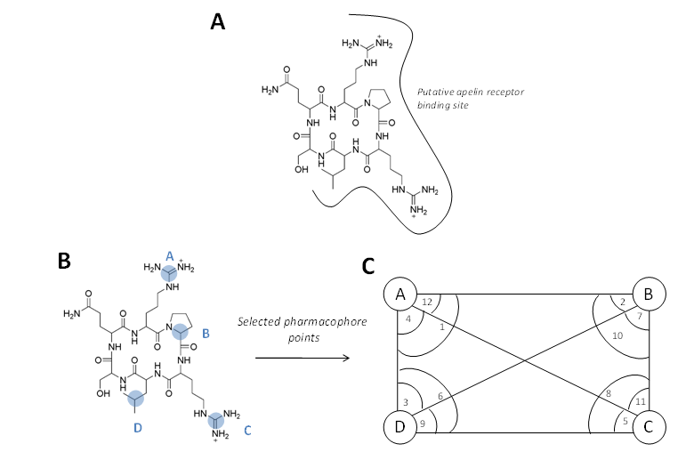
Pharmacophore points (putatively) deduced from structure-activity of cyclic peptides
(A) Schematic representation of compound 3 in the putative binding site of APJ, showing the proposed importance of the residues in positions 2-5. (B) Four selected pharmacophore points (A-D) highlighted in compound 3 (C) Six distance and 12 angle pharmacophore parameters between pharmacophore points A-D.
A

Slide 28
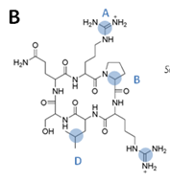
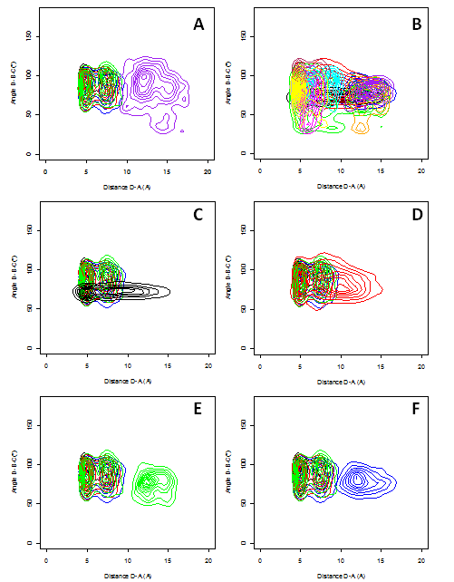
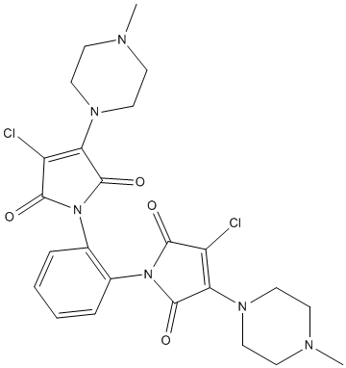
Quasi-pharmacophore analysis of peptides
Construct an overlaid pharmacophore
Choose points
Choose points
Simulate using molecular dynamics and analyse distances/angles etc.
3M
molecules
Small molecule screening
Example of molecule showing affinity
2-4µM

Slide 29
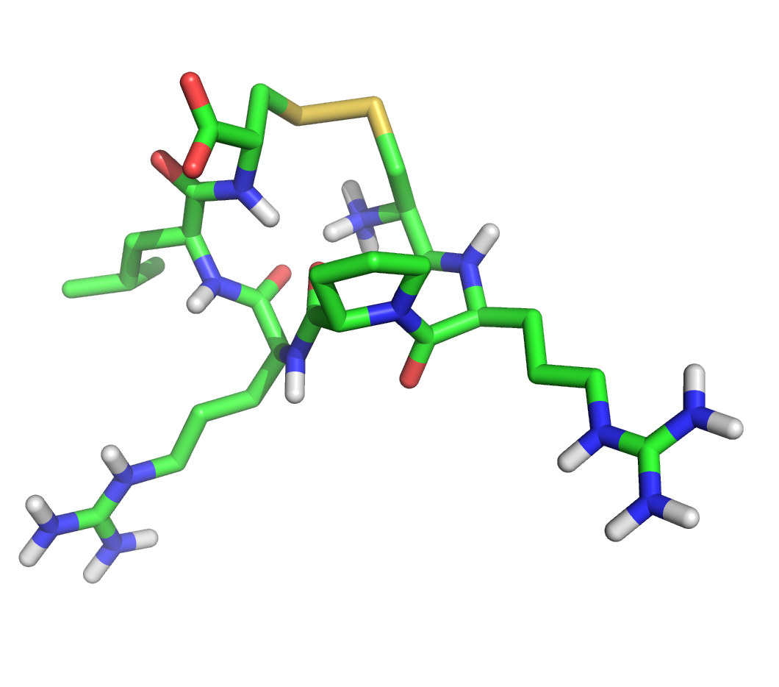
Generating a pharmacophore
‘Best guess’ at binding mode -
RPRL motif, β-turn from nmr-constraints and simulation
Example of molecule showing affinity
2-4µM
Hydrophobic pocket
Hydrophobic center
3.9Å
3.2 Å
H-bond Acceptor
H-bond Donor
7.6 Å
7.2Å
Ca. 15.5 Å
Positive Nitrogen
Positive Nitrogen
Probable (possible) distance between protonated species from small screening set

Slide 30
Modulating agonism - antagonists
We are unaware of any competitive antagonists at APJ. As a pharmalogical tool, an antagonist would be invaluable.
Some of the cyclic peptides we have made have very high affinity (pMol) and showed a range of potency from full agonists to partial agonists.
To create an antagonist at a GPCR, it is thought necessary to stabilise an ‘antagonist conformation’.
Therefore, a compound that bound with good affinity, and stabilised a (relevant) conformational change my do just this.

Slide 31

Apelin simulations
Hypothesis from data: Some sort of agonist ‘switch’
around here e.g. cyclo(1-6)CRPRLCHKGPMPF is a full agonist, while cyclo(1-6)CRPRLCKHGPMPF is a partial agonist
N-terminus
C-terminus

Slide 32
Design of novel analogues uses an approach of two ‘anchors’ with a variable linker.
RPRL b-structure
Anchor
Linker
Allosteric site
Anchor
‘switch’ at linker

Slide 33
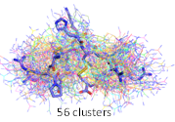
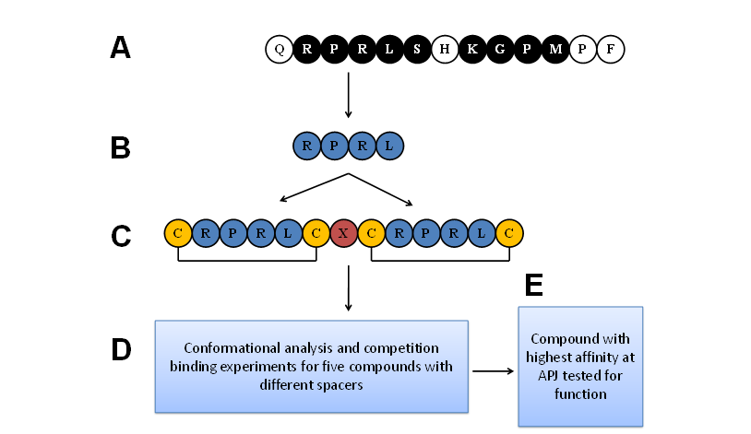
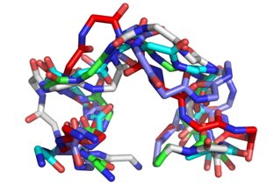
Compound | Sequence^{[a]} | % inhibition^{[b]} | IC₅₀ (nM) ^{[c]} | K_{i} (nM) ^{[d]}
apelin-13 | QRPRLSHKGPMPF | -
1 | [CRPRLC]-A-[CRPRLC] | 77 | - | -
2 | [CRPRLC]-AA-[CRPRLC] | 98 | 950 | 840
3 | [CRPRLC]-GG-[CRPRLC] | 63 | - | -
4 | [CRPRLC]-HK-[CRPRLC] | 86 | 1600 | 1400
5 | [CRPRLC]-KH-[CRPRLC] | 98 | 93 | 82

Slide 34
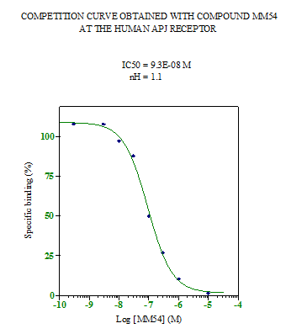
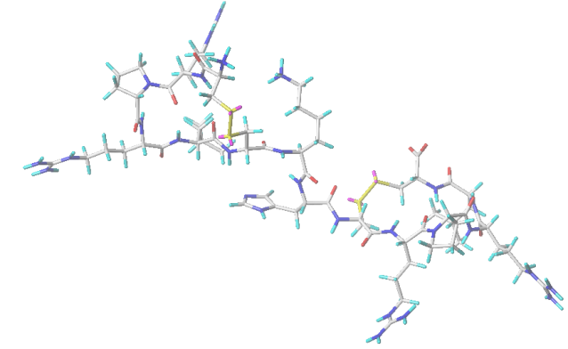
Bicyclic analogs β-turn content
Ligand | Sequence^{[a]} | β-turn content R2-L5 (%)^{[b]} | β-turn content R8-L11 or R9-L12 (%)^{[b]}
1 | [CRPRLC]-A-[CRPRLC] | 97 | 99
2 | [CRPRLC]-AA-[CRPRLC] | 82 | 95
3 | [CRPRLC]-GG-[CRPRLC] | 97 | 98
4 | [CRPRLC]-HK-[CRPRLC] | 82 | 100
5 | [CRPRLC]-KH-[CRPRLC] | 79 | 99
Compound | Sequence^{[a]} | % inhibition^{[b]} | IC₅₀ (nM) ^{[c]} | K_{i} (nM) ^{[d]}
apelin-13 | QRPRLSHKGPMPF | -
1 | [CRPRLC]-A-[CRPRLC] | 77 | - | -
2 | [CRPRLC]-AA-[CRPRLC] | 98 | 950 | 840
3 | [CRPRLC]-GG-[CRPRLC] | 63 | - | -
4 | [CRPRLC]-HK-[CRPRLC] | 86 | 1600 | 1400
5 | [CRPRLC]-KH-[CRPRLC] | 98 | 93 | 82

Slide 35

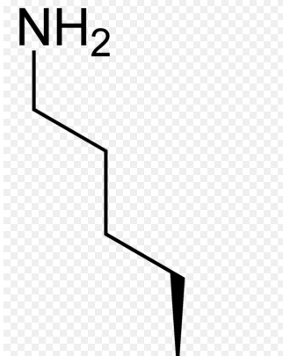
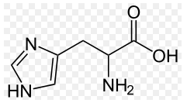

Linker design
NH₂
Y
X
RPRL b-structure
Anchor
Allosteric site
Anchor
RPRL b-structure
Anchor
Allosteric site
Anchor
Linker HK
Linker KH
X
Y
NH₂

Slide 36
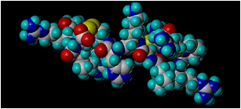
Cyclo(1-6)CRPRLC-KH-cyclo(9-14)CRPRLC (MM54)
is a competitive antagonist at the apelin receptor (cAMP assay)
Radioligand Binding in human left ventricle
cAMP assays in CHO-K1-APJ cells
% [¹²⁵I]Apelin-13 Bound
% (Pyr¹)apelin-13 response
MM54 conc. (M)
(Pyr¹)apelin-13 conc. (M)
Compound | K_{D} (M) | n
(Pyr¹)apelin-13 | 1.22x10⁻⁸ ± 2.78x10⁻⁹ | 3
MM54 | 3.42x10⁻⁶ ± 4.54x10⁻⁷ | 3
Compound | pA₂ | K_{D} (M)
MM54 | 5.88 | 1.32x10⁻⁶
K_{i} = 82nM (APJh CHO cells)
N. J. Maximilian Macaluso, Sarah L. Pitkin, Janet J. Maguire, Anthony P. Davenport, and Robert C. Glen. Discovery of a Competitive Apelin Receptor (APJ) Antagonist. ChemMedChem 2011, 6, 1017 – 1023

Slide 37
Additional ‘antagonists’ in testing (still doing the functional assays)
Compound sequence | %inhib | Description | B-arrestin
CRPRLCHKCRPRLC (no cycle) | 81 | No cycle | Ant
CRPRLCKHCRPRLC (no cycle) | 91 | No cycle | Ant
QRPRLSH-cyclo(8-13)CGPMPC | 42 | C-terminal cysteine replacement and cyclisation (no-K)
QRPRLS-cyclo(7-13)CKGPMPC | 89 | C-terminal cysteine replacement and cyclisation (no-H) | Pa
cyclo(1-6)CRPRLC-cyclo(7-13)KHGPMPF | 97 | Retains C-terminal sequence cyclised side-chain K (KH) to C-terminus | Pa
QRPRL-cyclo(6-11)CHKGPCPF | 101 | Retains C-terminal sequence cyclised around HK | Pa
QRPRL-cyclo(6-11)CKHGPCPF | 95 | Retains C-terminal sequence cyclised around KH | Pa

Slide 38
How do they work? Binding and dynamics at the apelin receptor
We have investigated a number of agonists, partial agonists and antagonists at the apelin receptor using molecular dynamics
Typically ca. 150nsec simulations, in membrane with a water bath.
Charmm (ff)/Amber accelerated by GPU technology.
Questions: what are the binding modes, interactions, and dynamics : can we relate these to potency, agonism and antagonism?

Slide 39
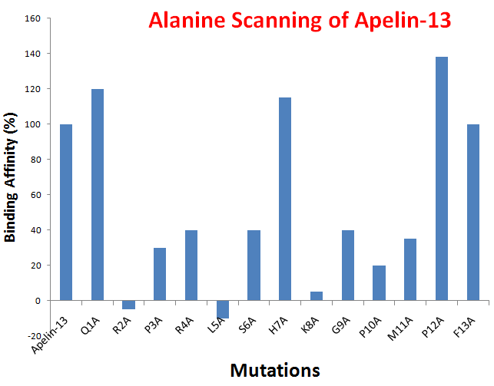
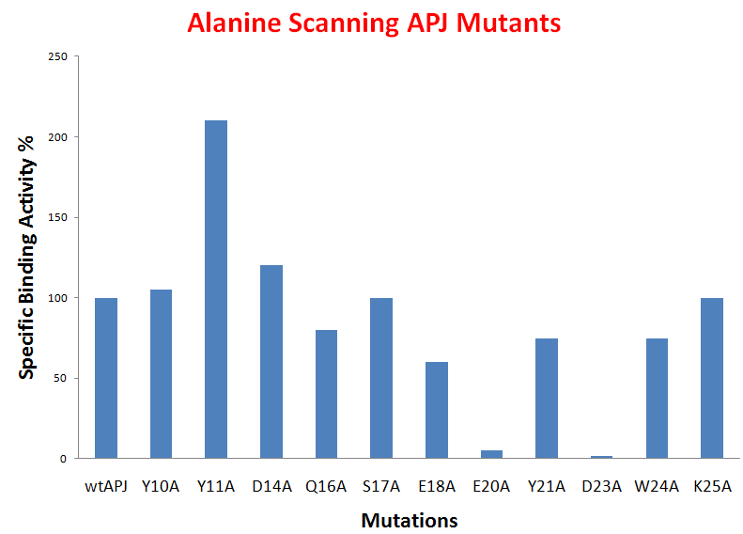
Interesting to compare with published mutagenesis data
Changing the sequence of the apelin peptide.
The N-terminal domain of APJ, a CNS-based co-receptor for HIV-1, is essential for its receptor function and coreceptor activity. Zhou N, Zhang X, Fan X, Argyris E, Fang J, Acheampong E, DuBois GC, Pomerantz RJ. Virology 2003 317(1), 84-94.
Changing the sequence of the APJ receptor.
Structural and functional study of the apelin-13 peptide, an endogenous ligand of the HIV-1 coreceptor, APJ. Xuejun Fan, Naiming Zhou, Xiaoling Zhang, Muhammad Mukhtar,Zhixian Lu, Jianhua Fang, Garrett C. DuBois and Roger J. Pomerantz. Biochemistry 2003, 42, 10163-10168.

Slide 40
pyrApelin-13
Structure homology modelled from CXCR4.
Tip3P water, lipid POPC
101815 atoms, box 98x98x101
Apelin inserted manually, energy minimised then equilibration for 20ns
Simulation for 150ns

Slide 41
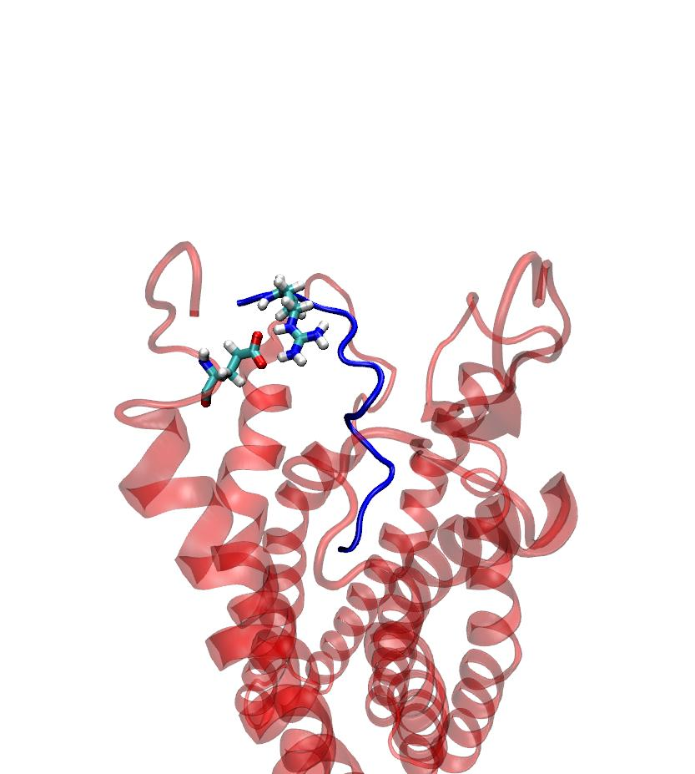
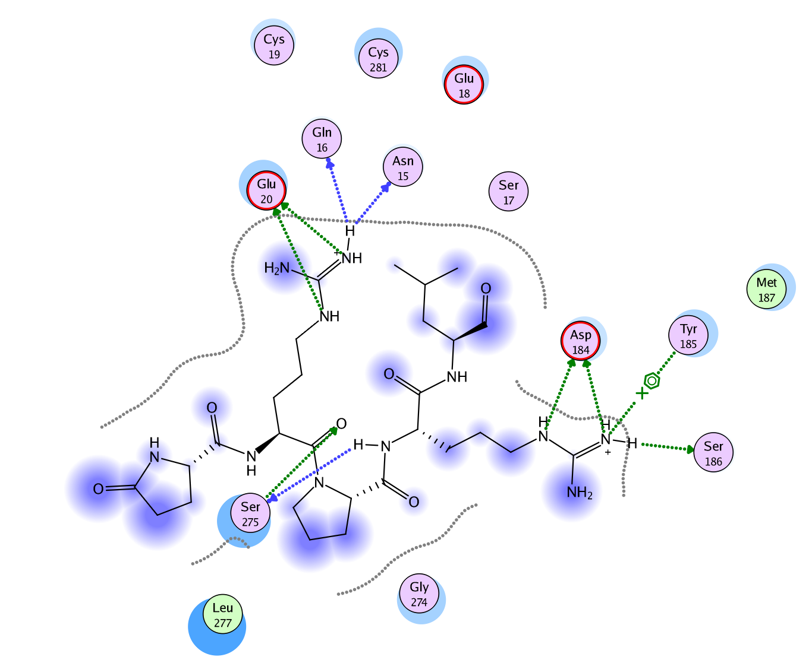
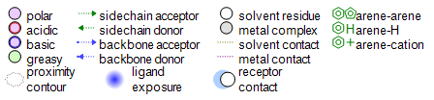
Pyr apelin-13 specific interactions QRPRL
(arginine)R2A – key interaction
(glutamic/Asn)

Slide 42
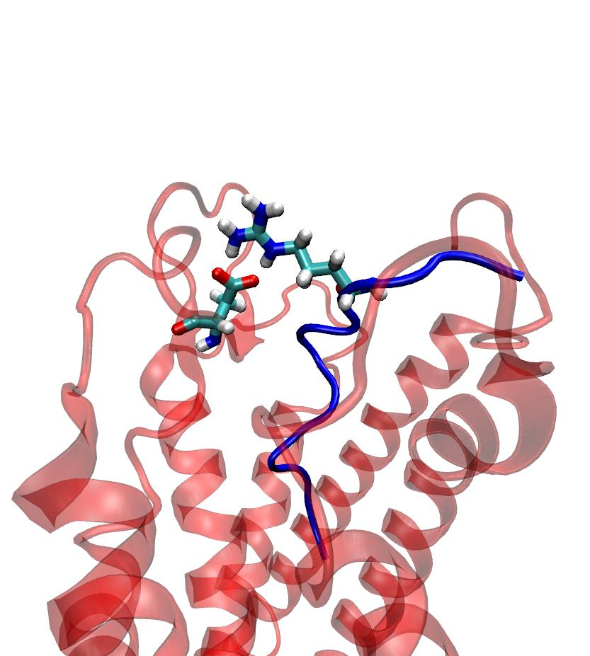
Pyr apelin-13 specific interactions QRPRL
(arginine)R4A – strong interaction
(aspartate/Ser)

Slide 43
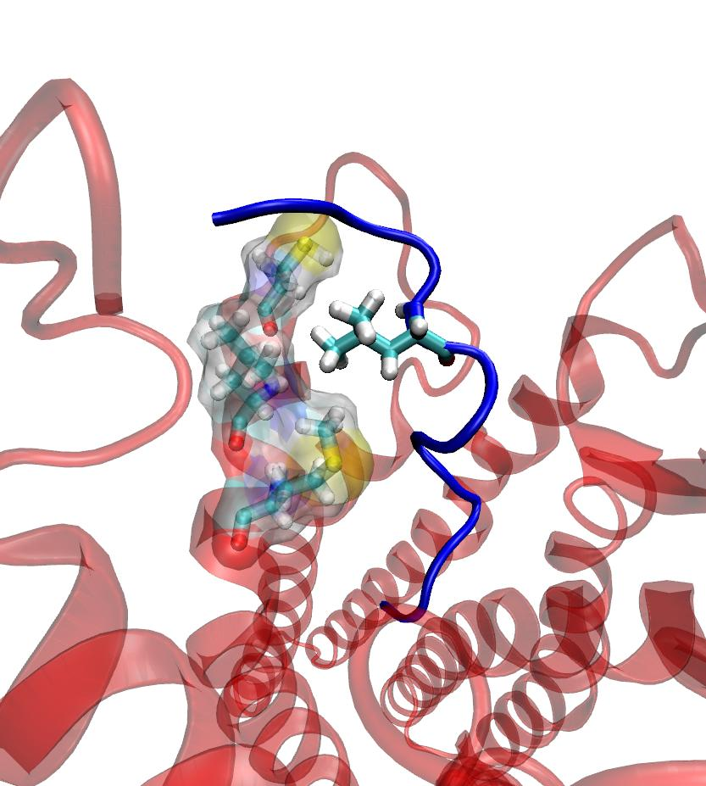
Pyr apelin-13 specific interactions QRPRL
(leucine) L5A – interaction pocket – we
think it stabilises the β-turn of RPRL

Slide 44
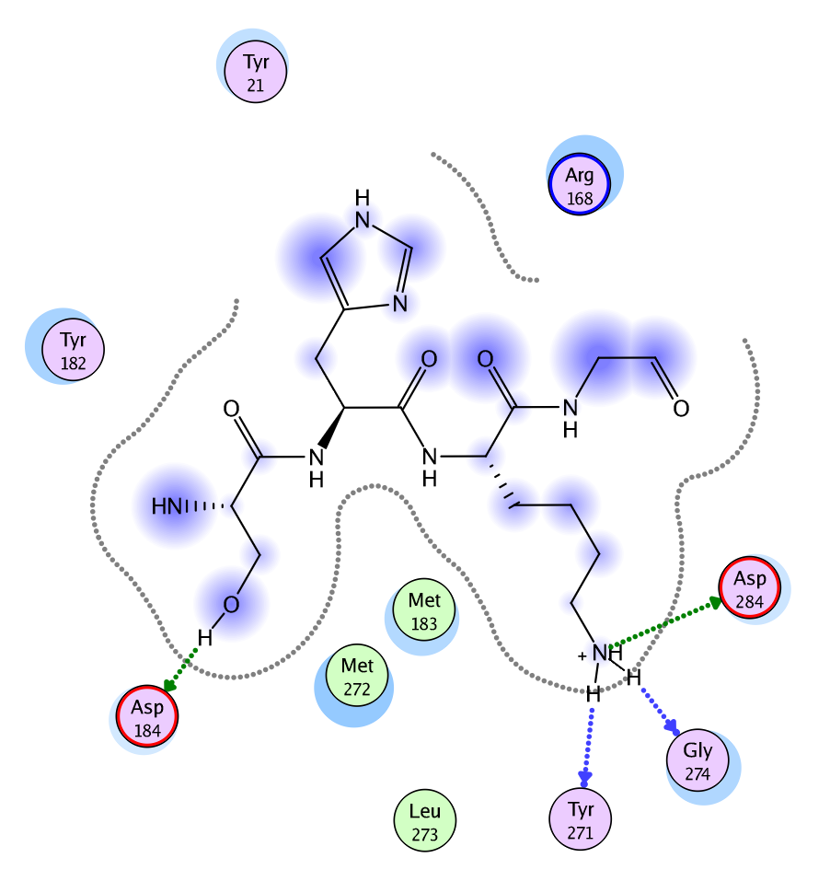
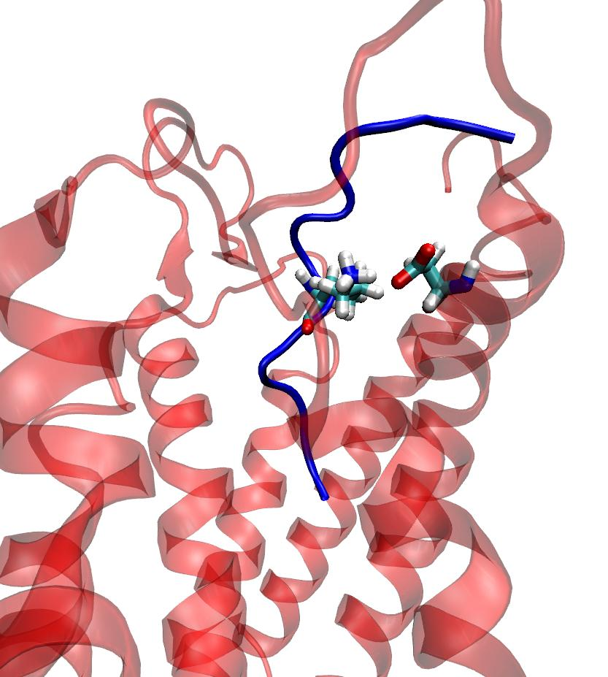
Pyr apelin-13 specific interactions SHKG
(lysine) K8A – key interaction
(Aspartate)
(also, see later on antagonism)

Slide 45
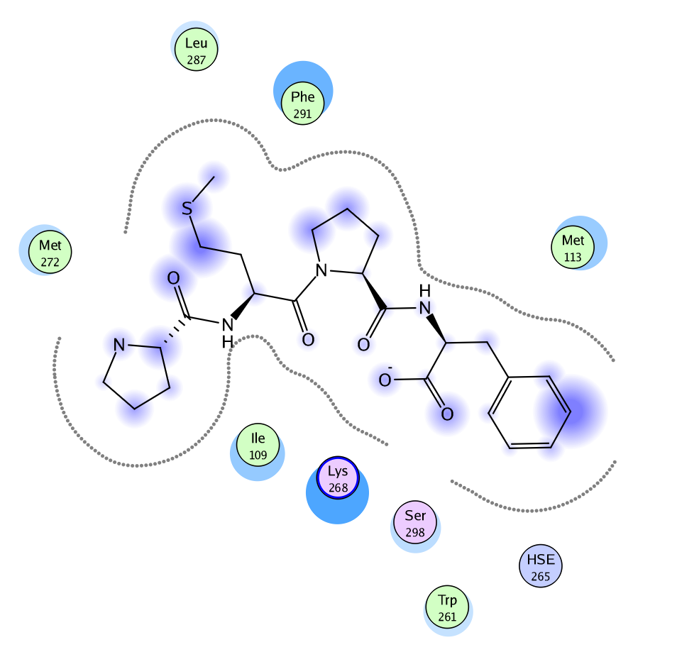
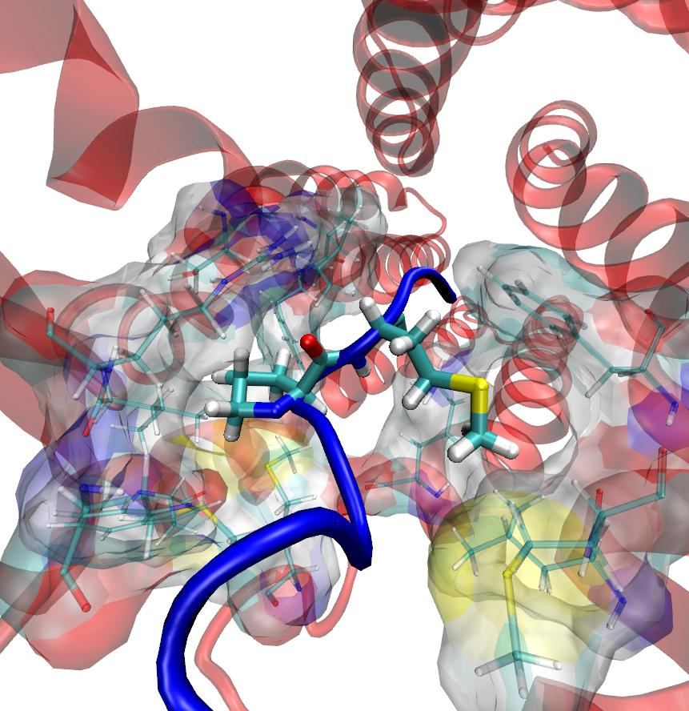
Pyr apelin-13 specific interactions PMPF
Proline10A and Methionine11A occupy hydrophobic pockets

Slide 46
Mutations of APJ
Glutamic acid20A – loss of key interaction – loss of affinity

Slide 47
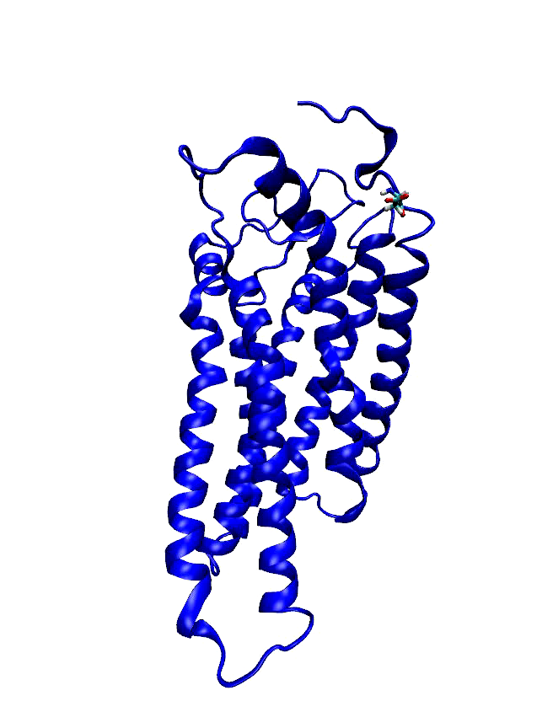
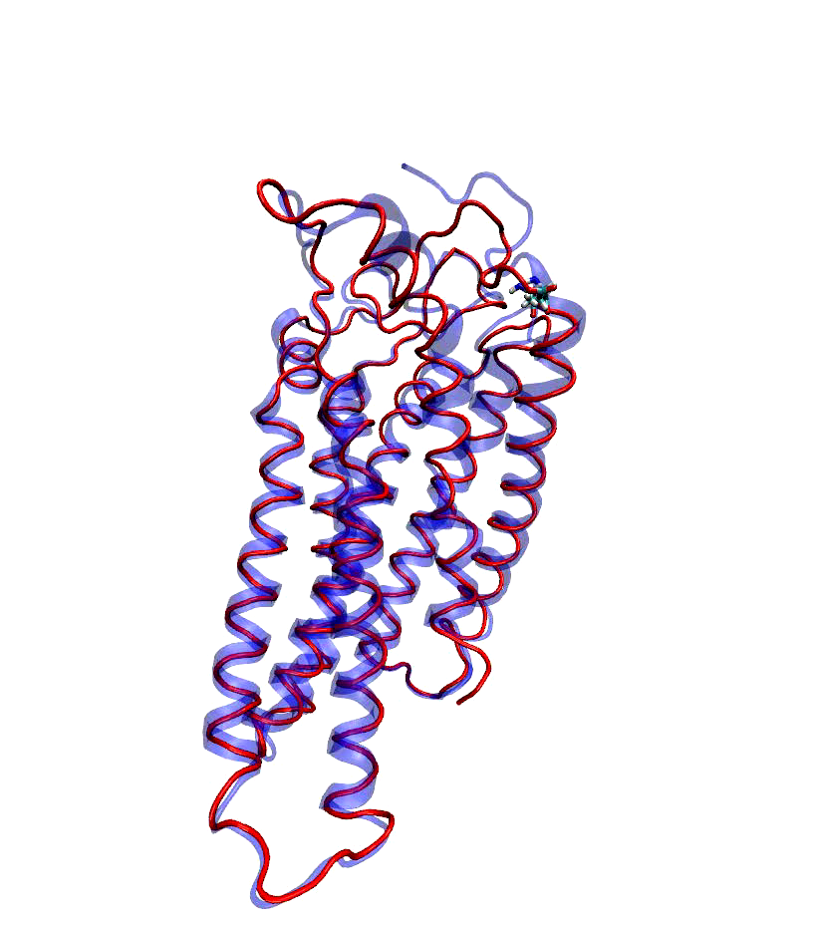
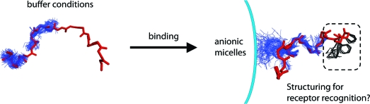
Mutations of APJ
D23A – part of the N-terminal sequence
which is unstructured in the wild type – but
becomes helix in the mutation.
We hypothesised that this region templates the RRL region to a β-turn to enable recognition at the first stage of binding. See also reference:
Headgroup-Dependent Membrane Catalysis of Apelin−Receptor Interactions Is Likely. David N. Langelaan and Jan K. Rainey. Phys Chem B. 2009 July 30; 113(30): 10465–10471
Wild type
Mutated Asp>ala)
This fits in with a 2-step recognition
Process-
Step1 – recognise templated β-turn
Step2 – insertion of sequence into receptor pore
The stable α-helix prevents this, hence loss of binding

Slide 48
Mechanism of antagonism?
Pyr-apelin13 (pyr-QRPRLSHKGPMPF) is an agonist
[CRPRLC]HK[CRPRLC] is an agonist
[CRPRLC]KH[CRPRLC] is an antagonist
We identified a significant alteration in the Interaction with Lysine8 (apelin) with asparate284 (APJ)
The antagonist ‘locks’ the aspartate in the apo conformation (inactive) while the agonist moves the helix-7 downwards significantly (possibly the active conformation), so transmitting a signal internally (just as it was ‘supposed’ to do).

Slide 49
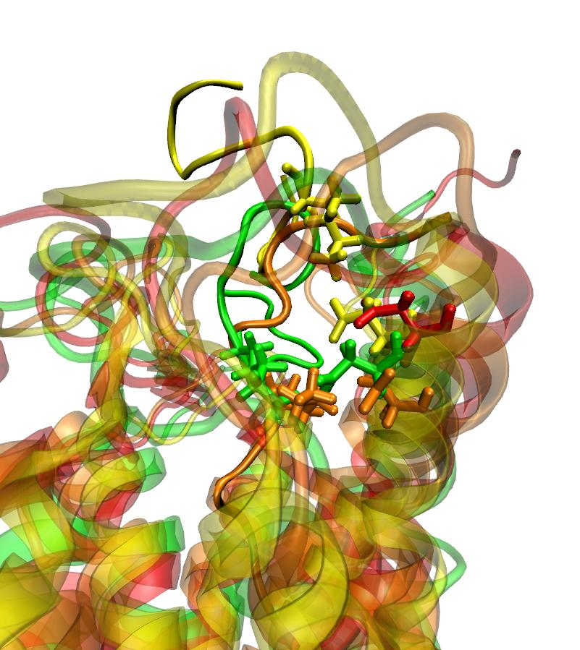
Mechanism of antagonism?
Apo structure of APJ (red)
Pyr-apelin13 (pyr-QRPRLSHKGPMPF) is an agonist (Orange)
[CRPRLC]HK[CRPRLC] is an agonist (Green)
[CRPRLC]KH[CRPRLC] is an antagonist (Yellow)
We identified a significant alteration in the Interaction with Lys8 (apelin) with Asp284 (APJ)
The antagonist ‘locks’ the aspartate in the apo conformation (inactive) while the agonist moves the helix-7 downwards significantly (possibly the active conformation), so transmitting a signal internally.

Slide 50
Biased agonism – a new emerging concept in GPCR pharmacology
2nd messenger
pathway
Β-arrestin pathway
G protein signalling
Rapid onset
Desensitisation
2nd messenger
Arr
Arrestin signalling
Slower onset
Sustained duration
Signalsome-dependent
Response
AC
PLCβ
Ion channel
TK
MAPK
E3 Ligase
G protein dependent
signalling
Arrestin-Dependent signalling
Seconds-minutes
Minutes-hours
New class of drugs?
Beyond Desentization: Physiological Relevance of Arrestin-Dependent Signalling. Louis M. Luttrell and Diane Gesty-Palmer. Pharmacologicl Reviews, 62:305-330, 2010.

Slide 51
The cyclic analogue MM07 inhibits apelin binding with similar affinity & potently constricts endothelium denuded human saphenous vein with a comparable potency (pD2) and efficacy (Emax) to (Pyr1)apelin-13 but is 500 fold less effective in recruiting β-arrestin – a biased agonist?
(Pyr¹)Apelin-13
MM07
MM07 – [CRPRLC]HKGPMPF
Ki=270nM (CHO hAPJ)
Competition analysis in heart:
K_{D}=0.85nM
Competition analysis in heart:
K_{D}= 23.9 nM
Potency in B-arrestin assay 7.4 nM (FAST)
Potency in B-arrestin assay 3900 nM (SLOW)
Apelin Peptide pD₂ E_{max}(%KCl) n
[Pyr¹]apelin-13 9.82±0.77 20.01±1.13 5
MM07 10.53±0.24 21.80±5.72 3
pD₂: negative logarithm to the base 10 of the EC₅₀, E_{max}: maximum response obtained

Slide 52
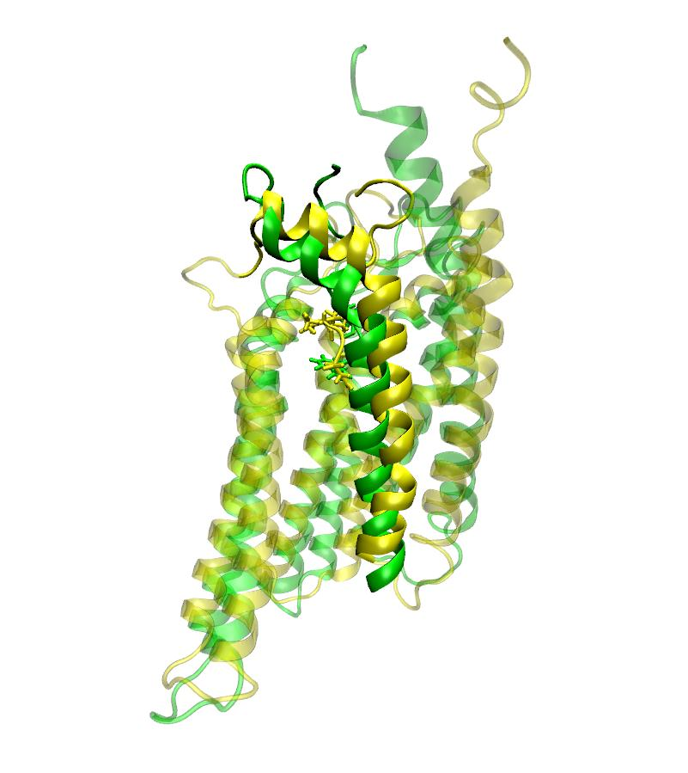
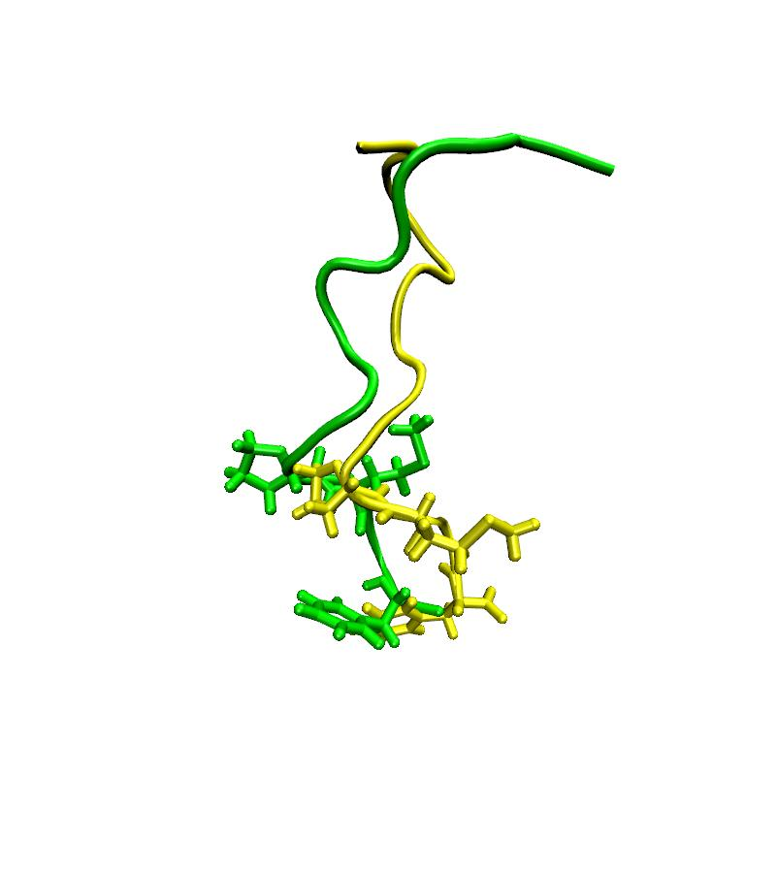
Differences between Apelin (full agonist) andMM07 (biased agonist), showing motion of the 7-helix and associated -C terminal loop. (50ns)
Conformation of pyr-apelin13 (green) and MM07 (Yellow)
MM07 causes helix-7 to move upwards
relative to the membrane (seems to be the influence of the methionine)
TM-7 (yellow) moves upwards by one turn, pulling the C-terminal loop into the membrane ??, loss of GRK binding pocket,
reduces phosphorylation by GRK and loss of recruitment of β-arrestin? (50ns)

Slide 53
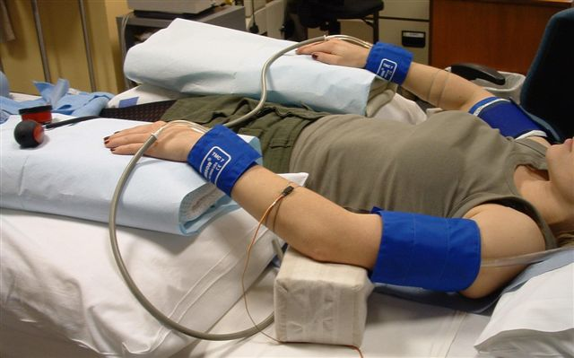
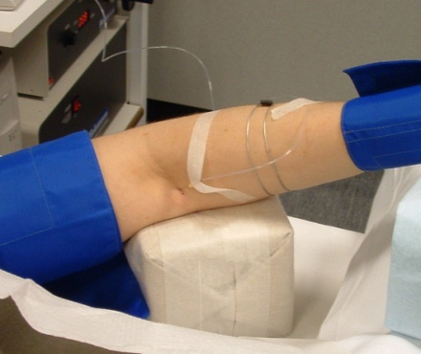
First human experiments. Forearm blood-flow study using agonist, antagonist and ‘biased’ agonist
The FBF procedure works in the following manner. Firstly a needle is inserted into the brachial artery of volunteers and a low concentration of peptide or compound (typically 1000 fold or 100 fold less than the systemic dose) is infused, thereby minimizing any potential side-effects or toxicology issues. A blood pressure cuff is placed around the upper arm and intermittently inflated to 40mmHg in order to occlude venous outflow and another cuff is placed around the wrist to exclude hand effects. This results in an increase in volume of the forearm, which is proportional to blood flow and can be measured by a ‘mercury-in-silastic strain gauge’ (see picture). First compound (pyr-Apelin-13 was tested – obtained dose ranging parameters). Three more compounds to follow (MM54, MM07, Apelin-12).

Slide 54
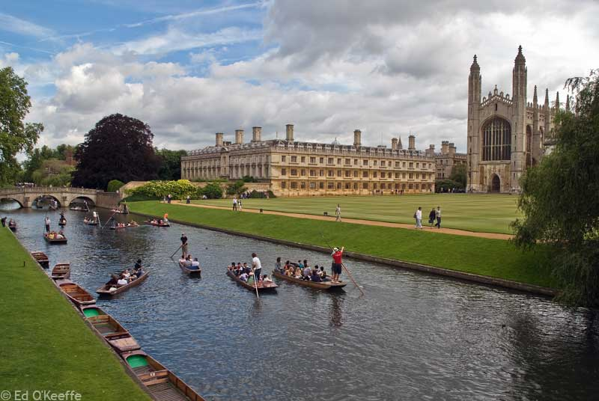

Acknowledgements
Apelin
Max Macaluso (PhD Gates Cambridge Trust), Zhi Wang (Beijing University of Chemical Technology, exchange student)
Anthony Davenport and Sarah Pitkin (PhD British Heart Foundation), Nick Morrell (Clinical Pharmacology), Addenbrookes, Cambridge
Paul Sanderson, Unilever Colworth (NMR studies)
CEREP for binding assays
Designer Bioscience and Cambridge Peptides for synthesis
Unilever for support and funding

